Slide 1
What’s new in GINA 2024?
GINA 2024 update published 22 May 2024 Download from ginasthma.org

Slide 2
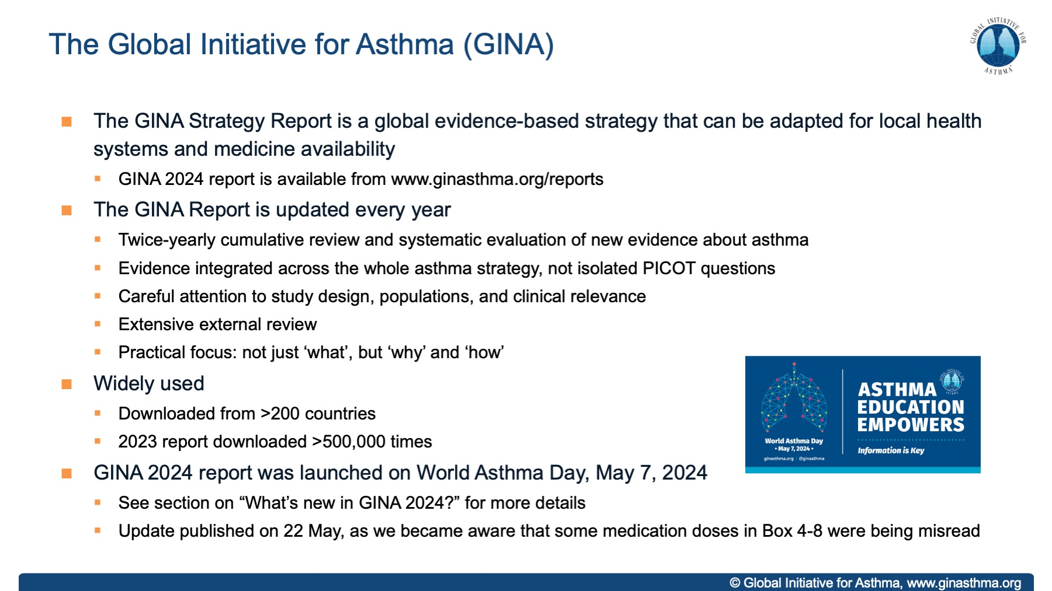

Slide 3
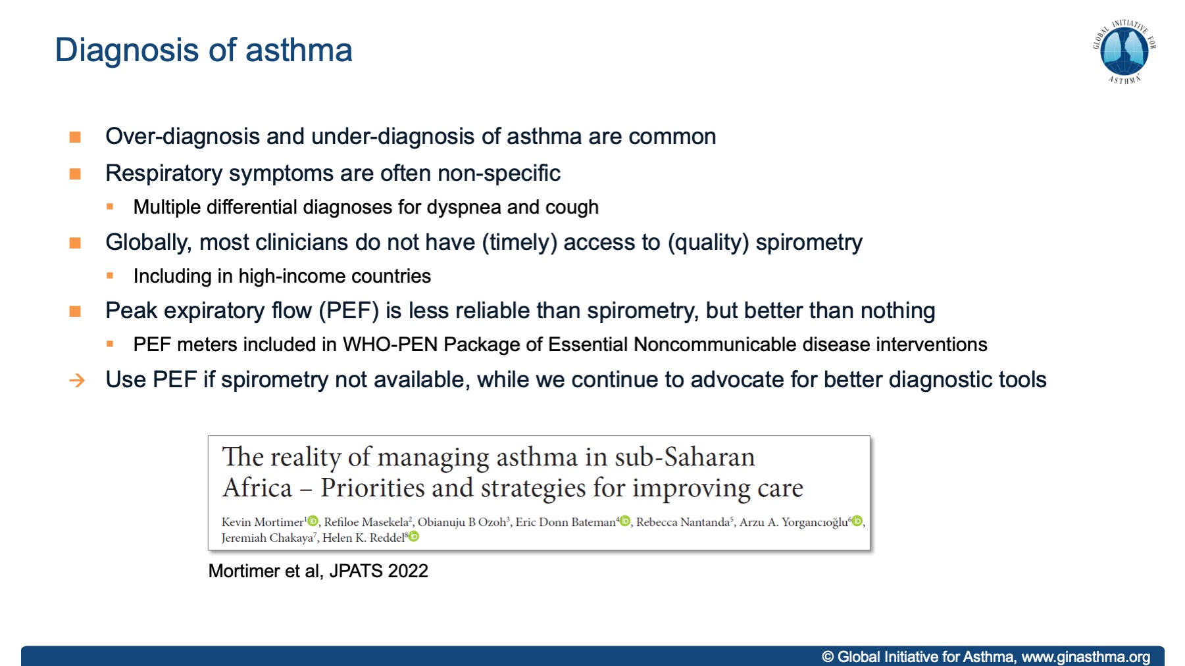

Slide 4
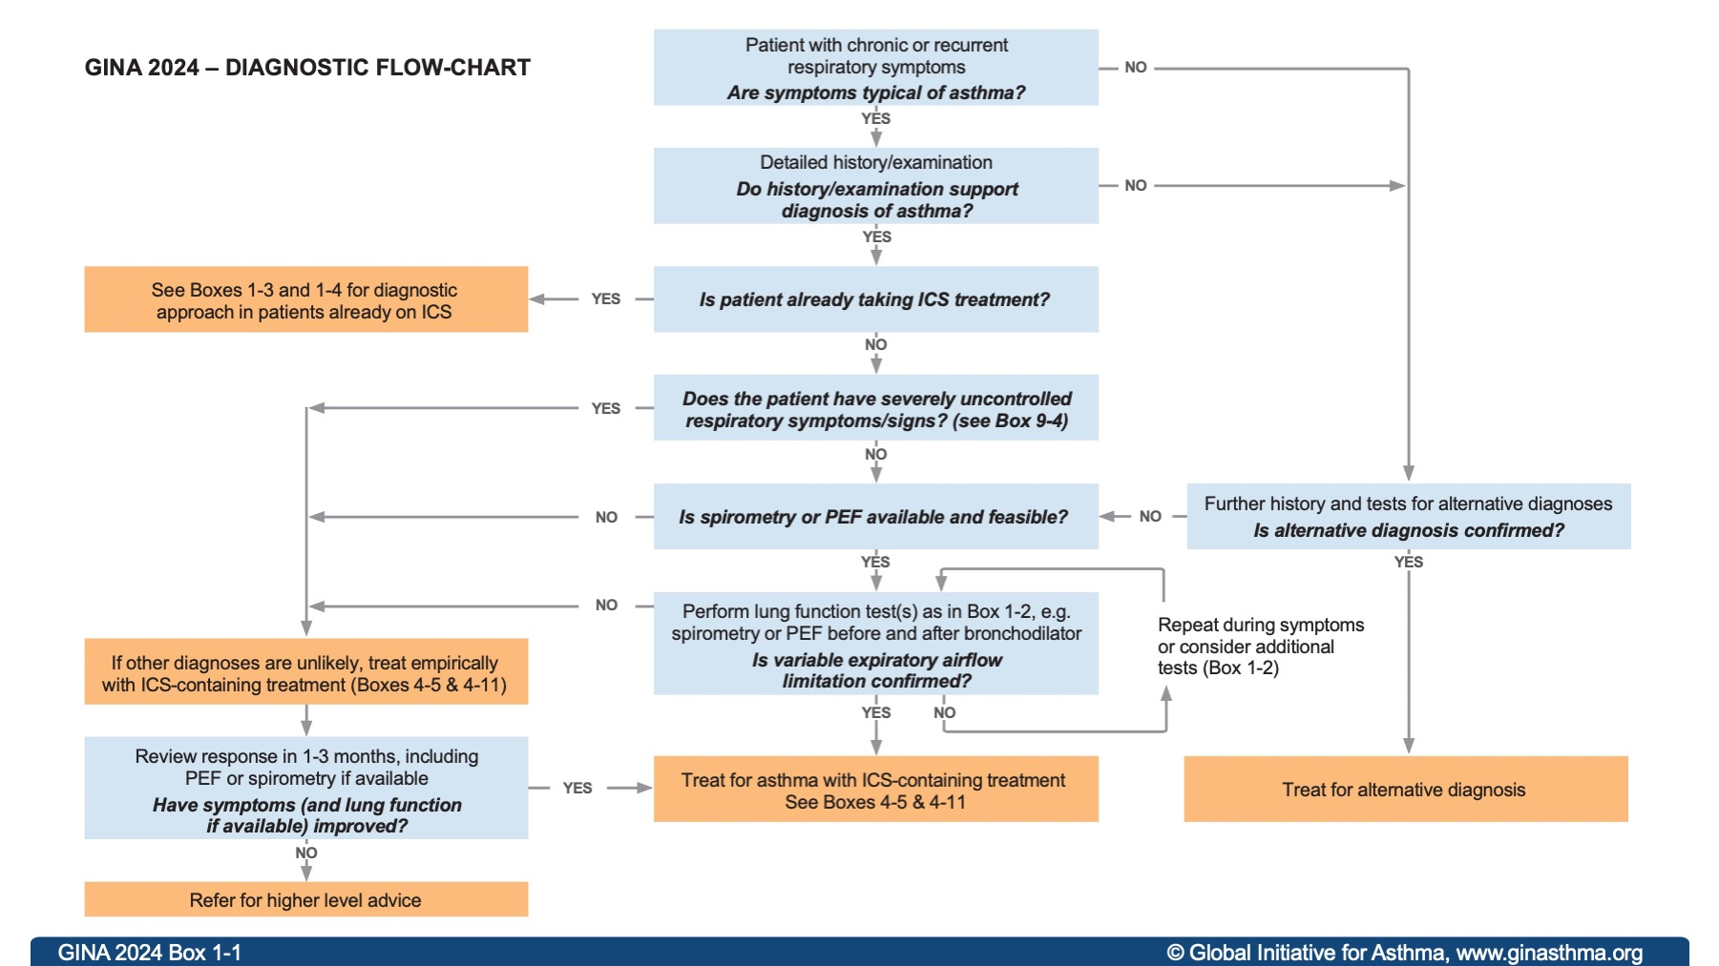

GINA 2024 Box 1-1

Slide 5
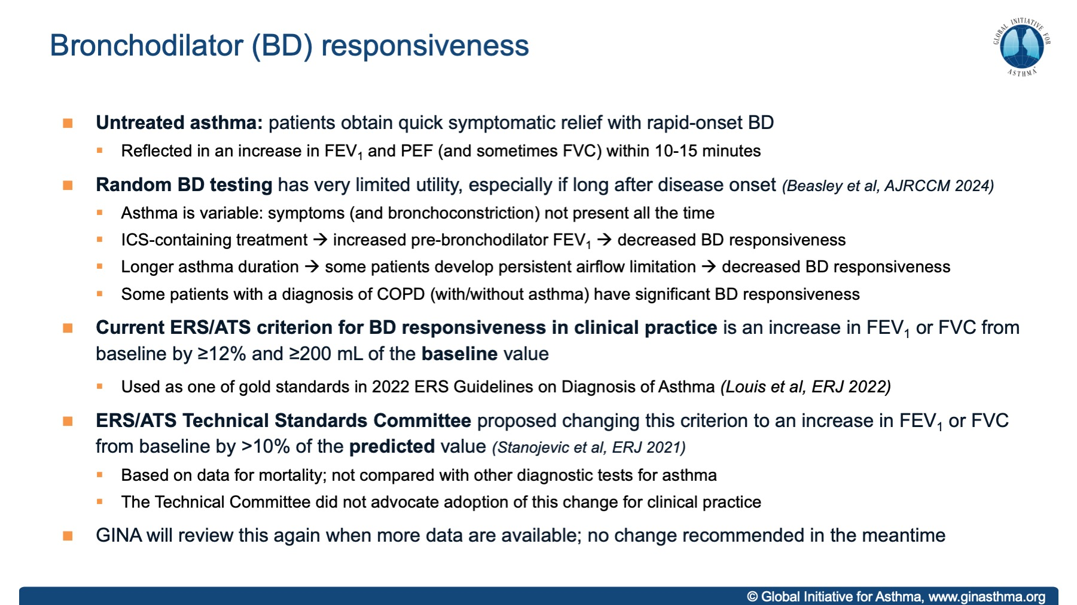

Slide 6
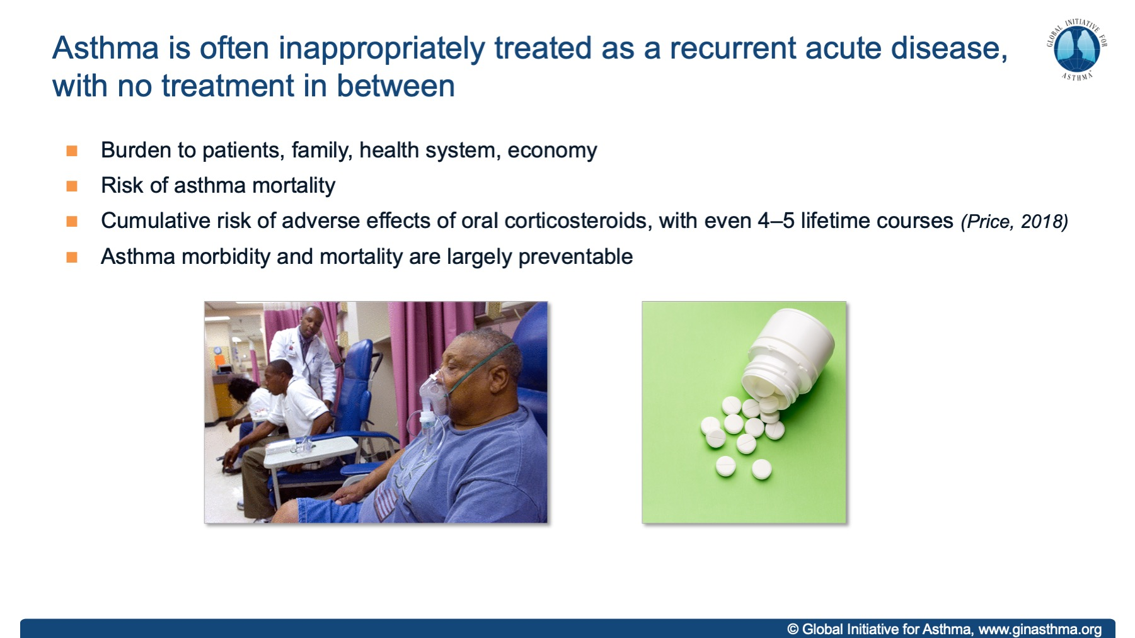
Notes:
Rather than chronic and preventative care

Slide 7
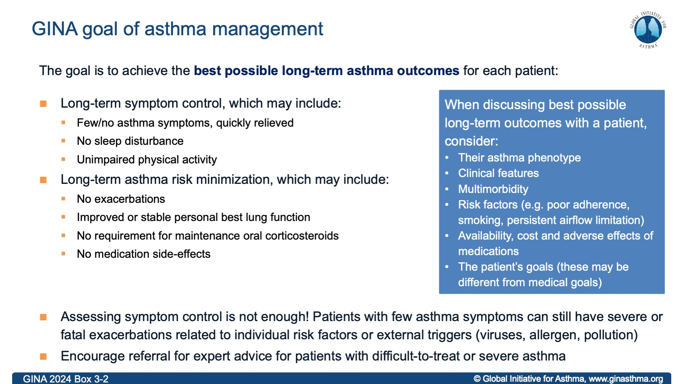
Notes:
NOTE: this slide is also repeated later, with slides about remission

Slide 8
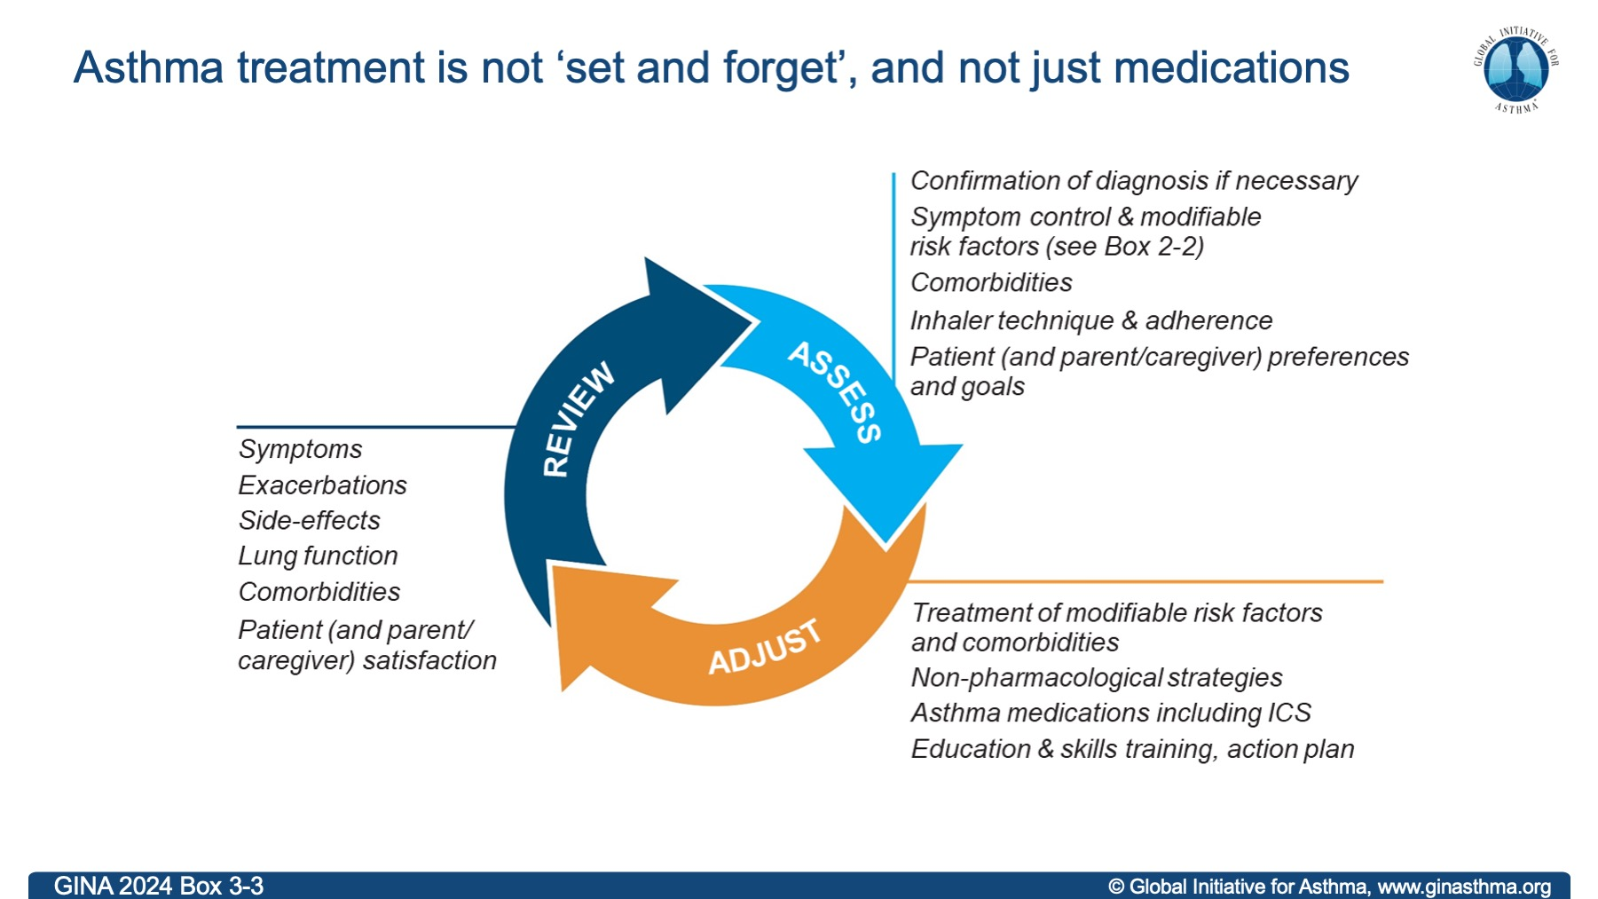

Slide 9
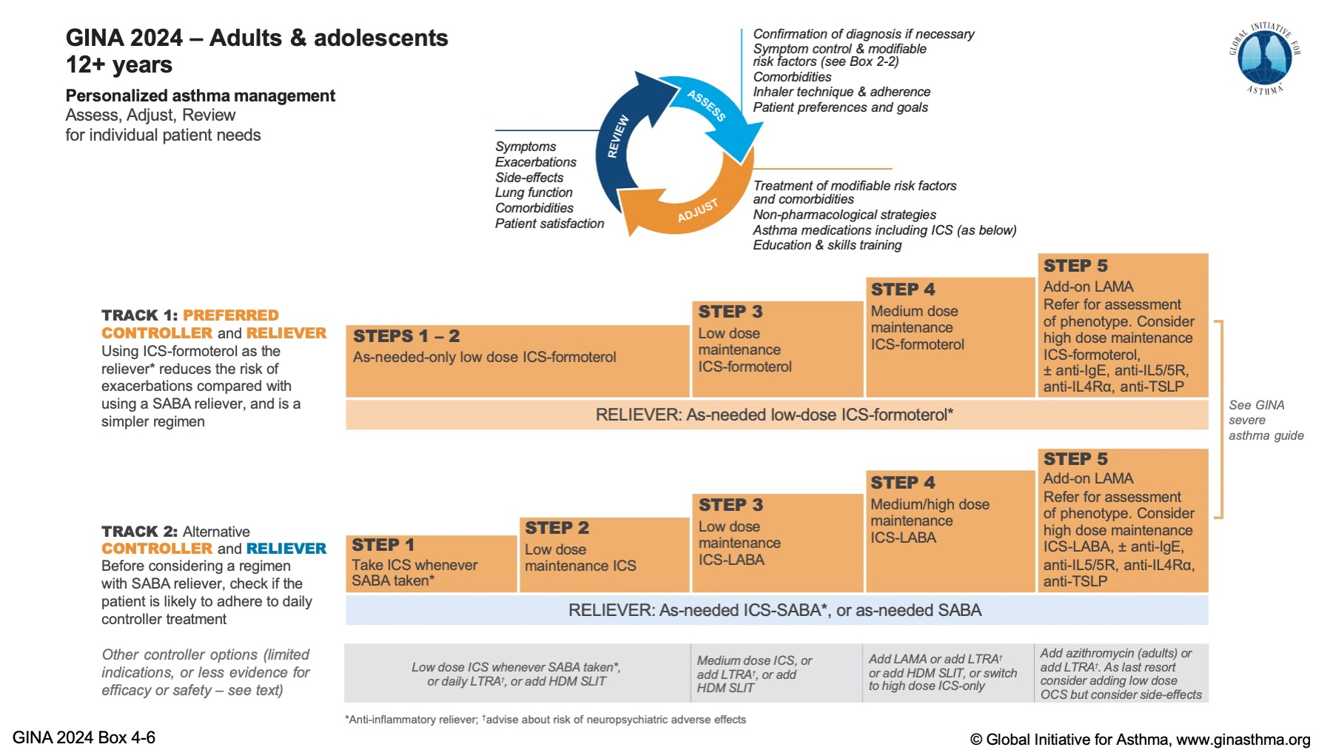

Slide 10
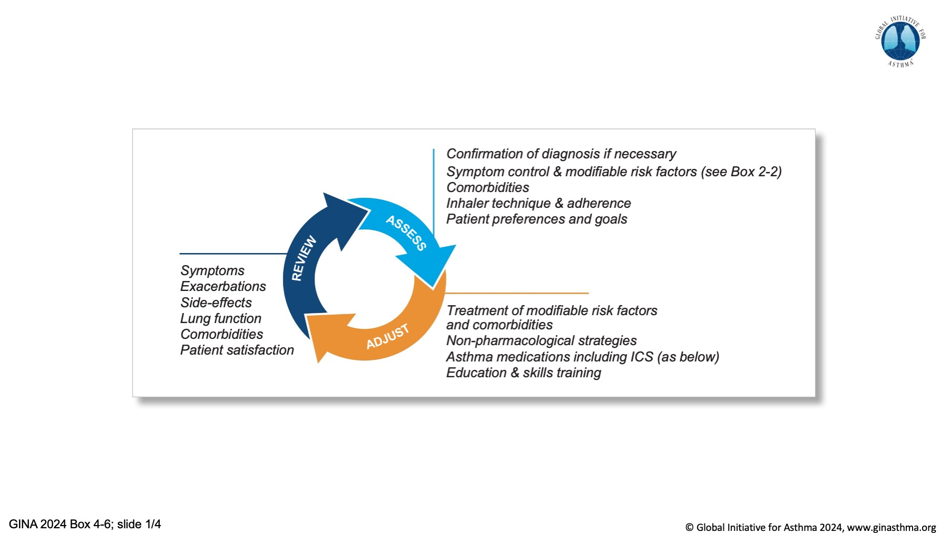

Slide 11
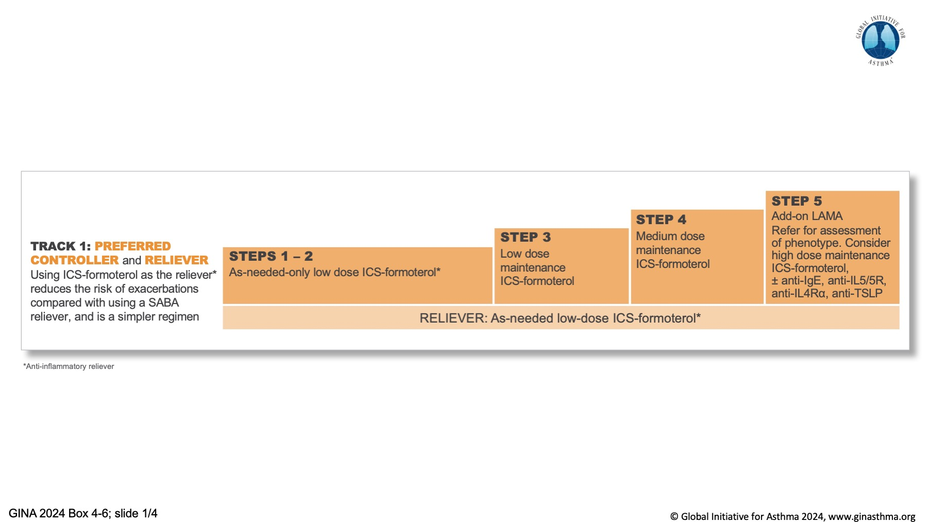

Slide 12
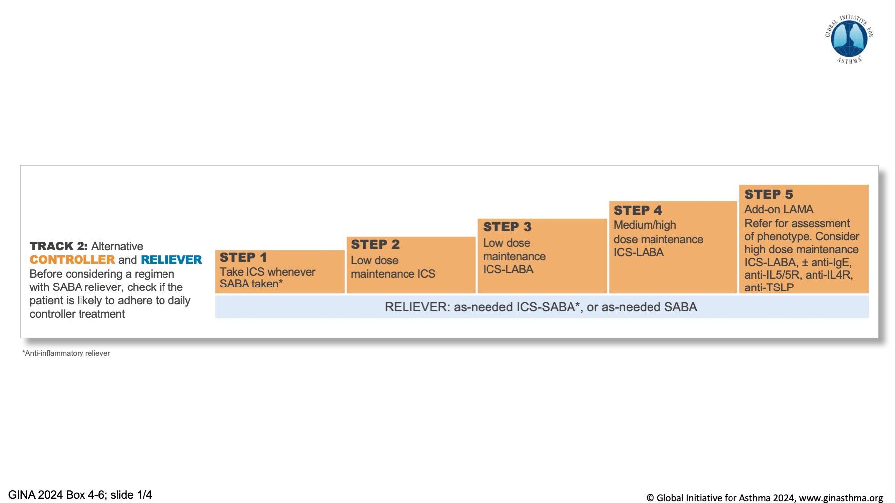

Slide 13
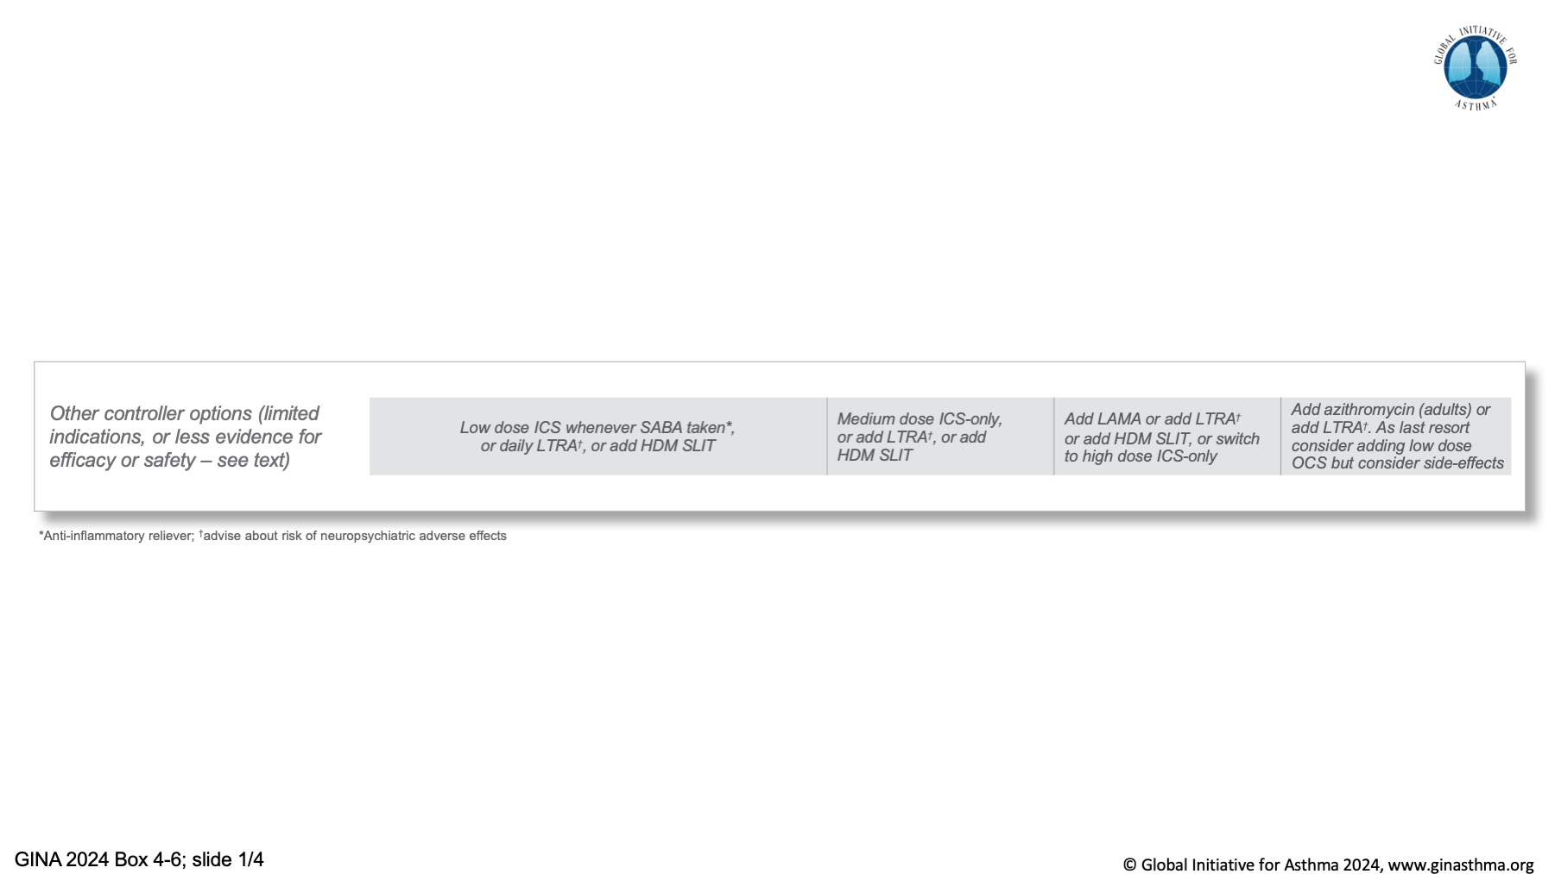

Slide 14
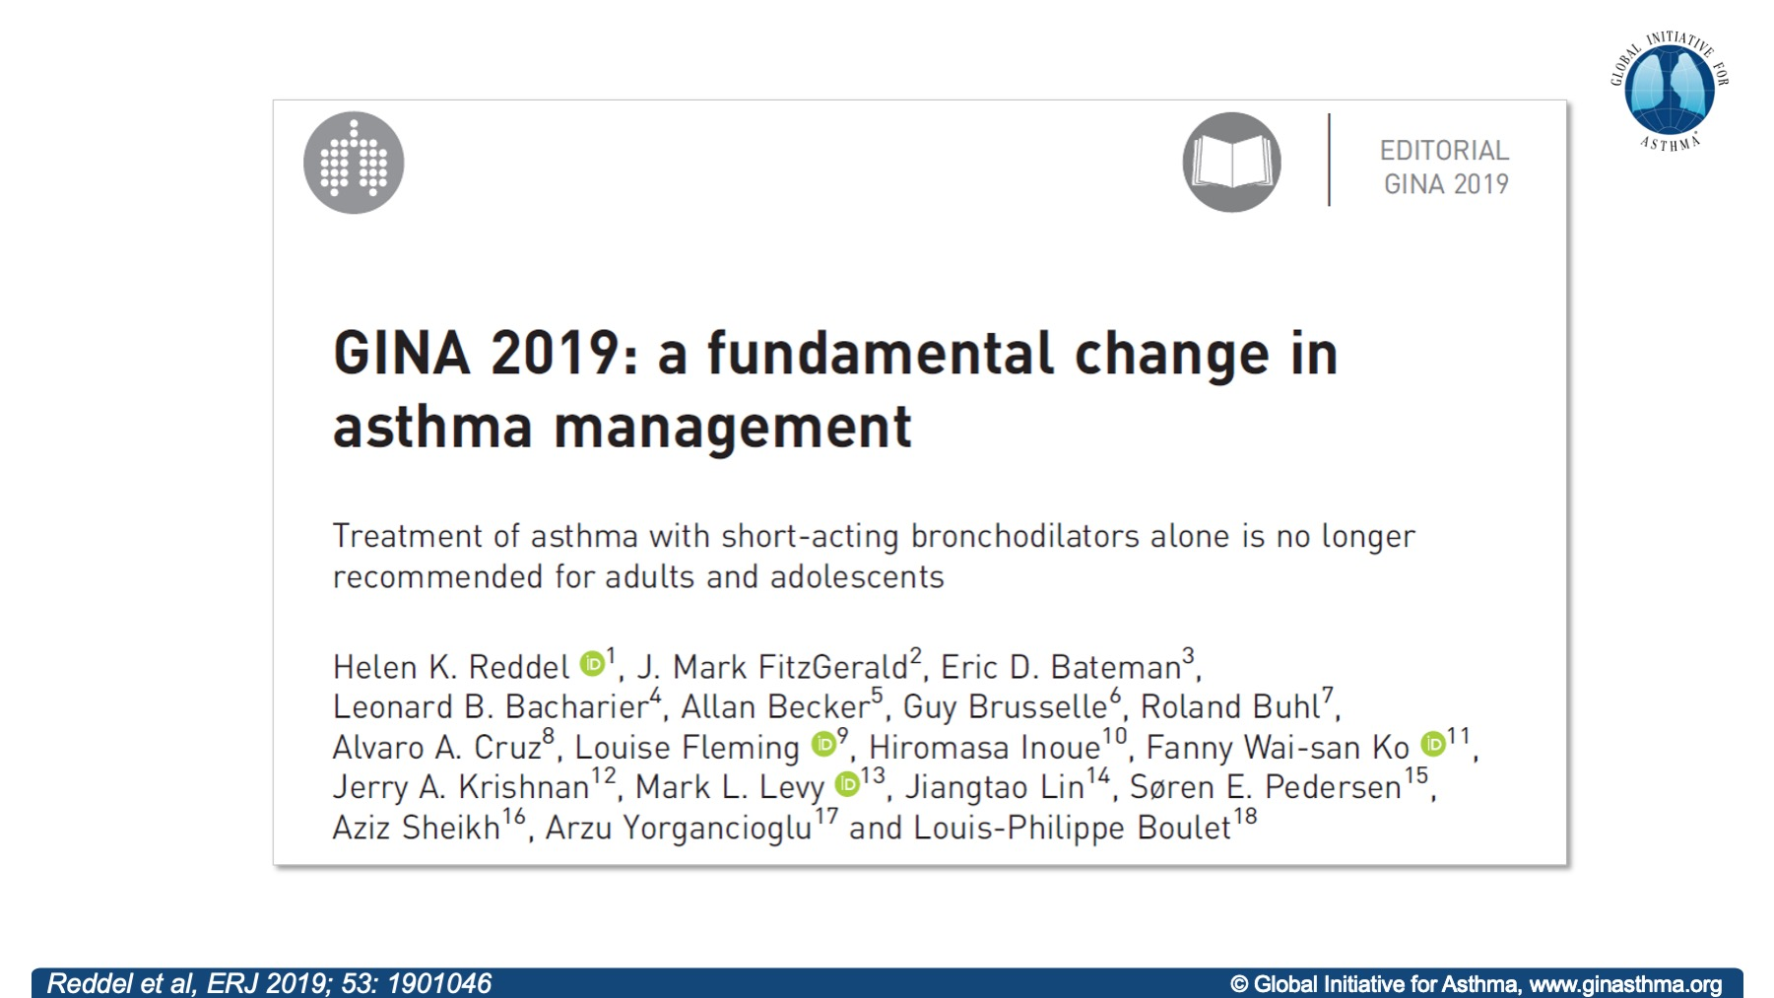

Slide 15
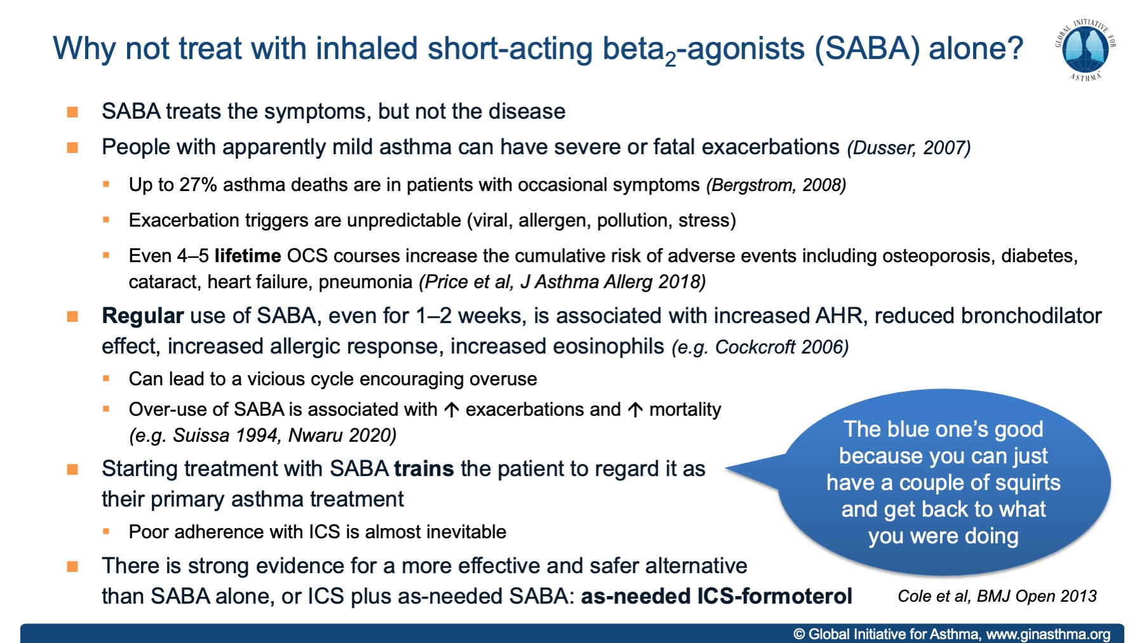

Slide 16
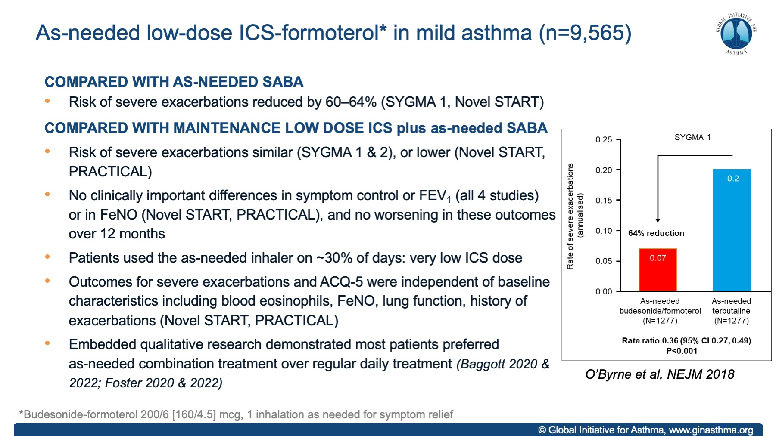

Slide 17
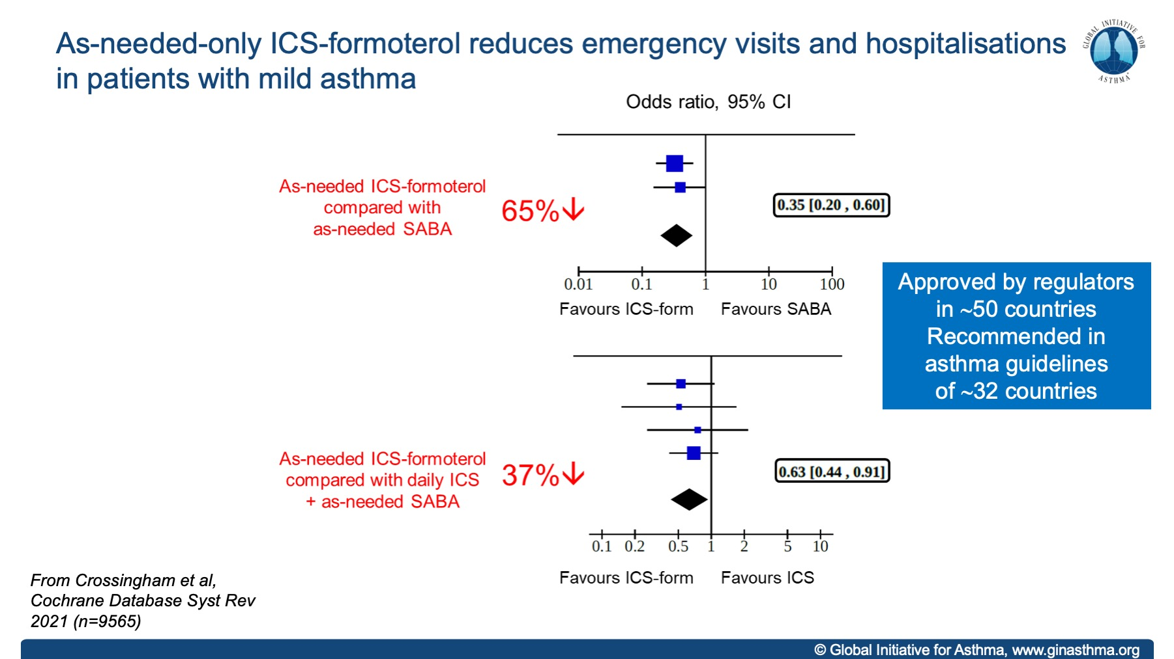

Slide 18
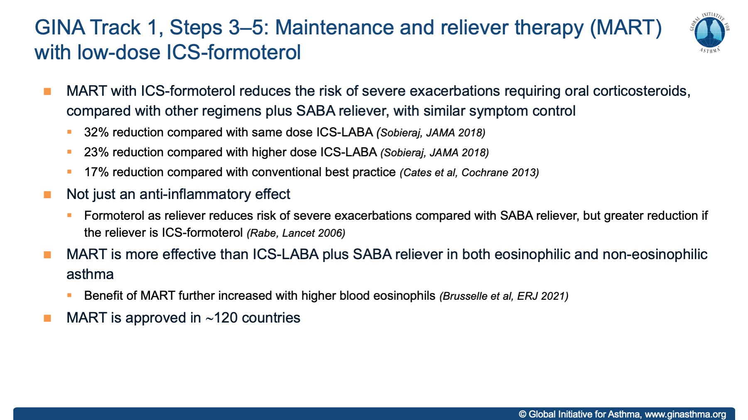

Slide 19
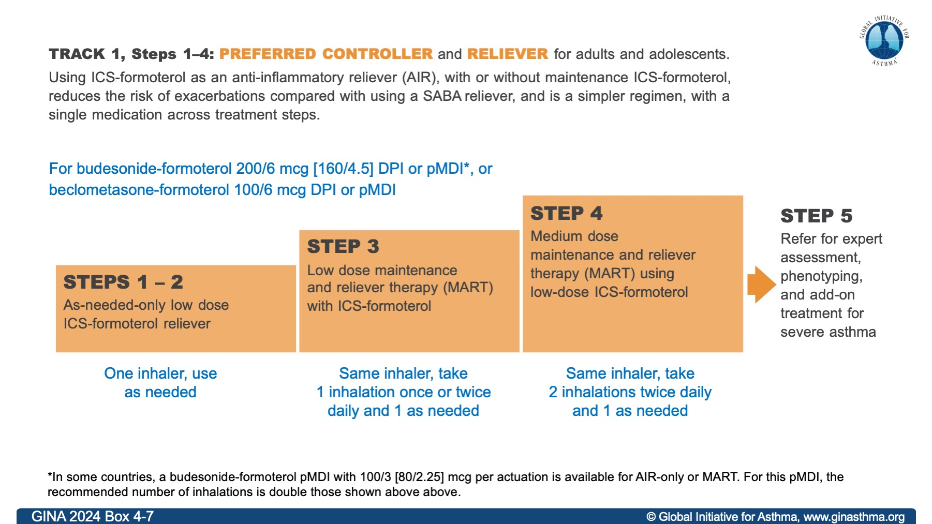

Slide 20
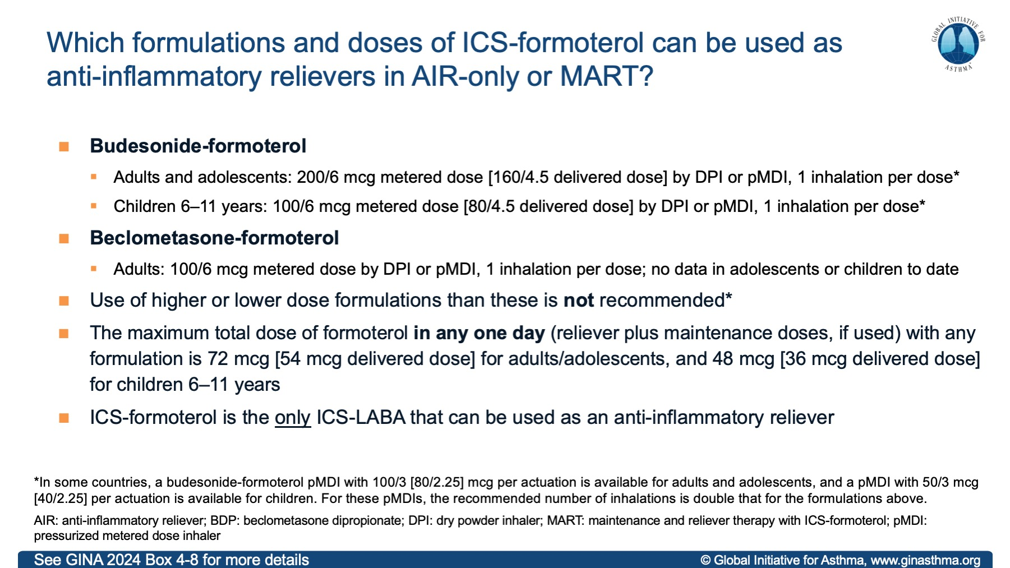

Slide 21
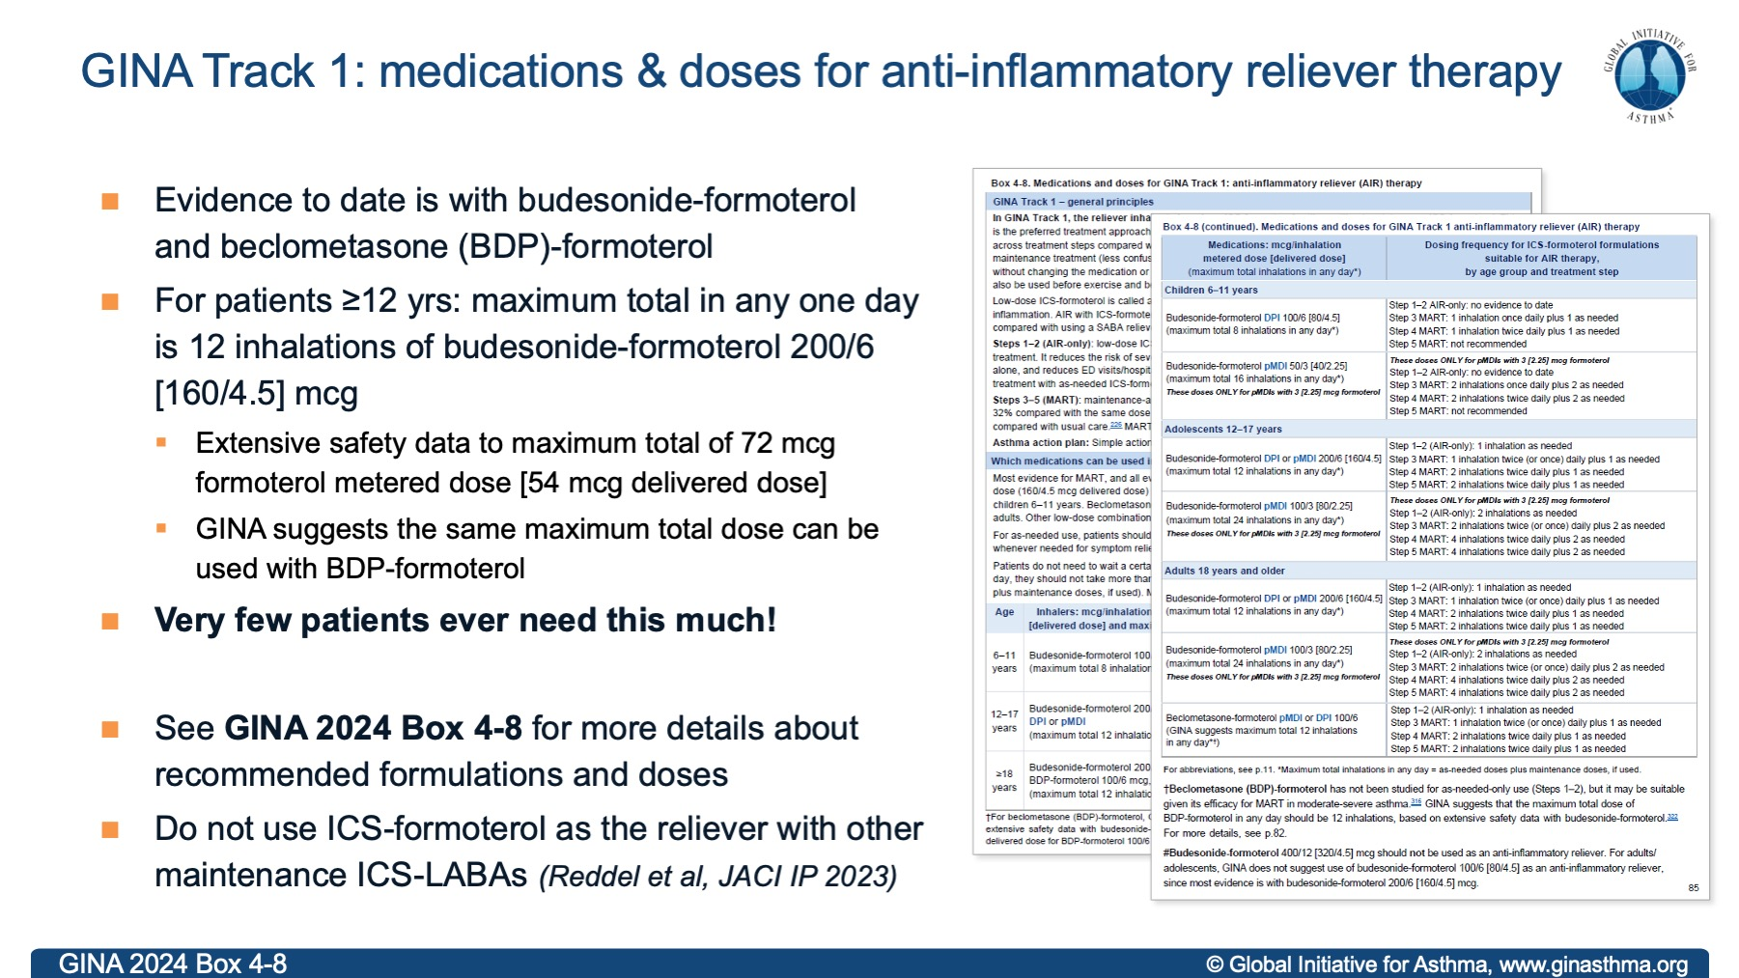

Slide 22
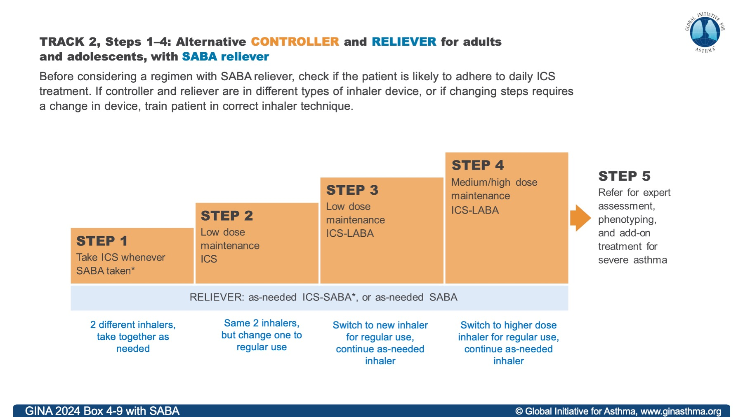
Notes:
Speakers: choose between this slide and the next slide depending on whether combination ICS-SABA is available in the country for which you are giving the presentation

Slide 23
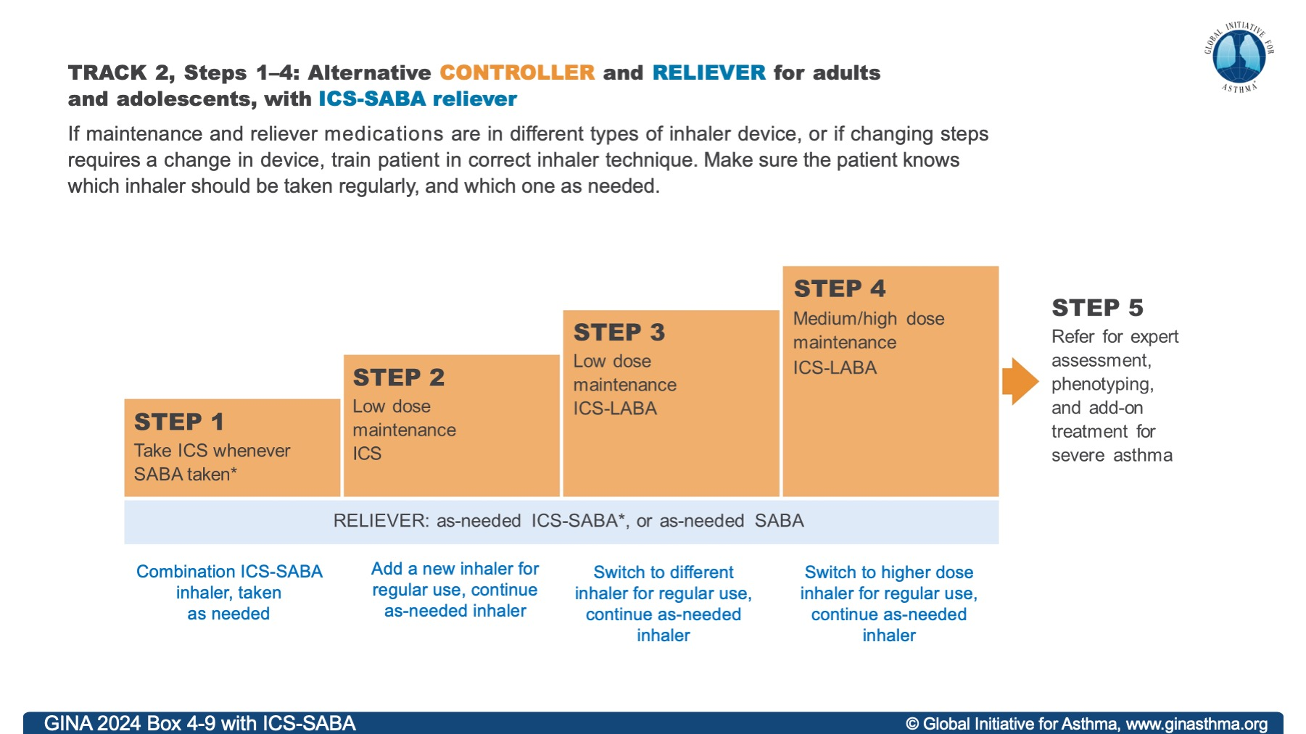
Notes:
Speakers: choose between this slide and the previous slide depending on whether combination ICS-SABA is available in the country for which you are giving the presentation

Slide 24
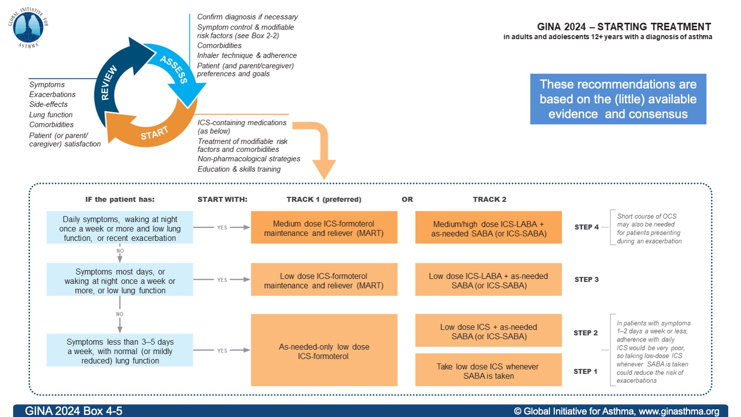

Slide 25
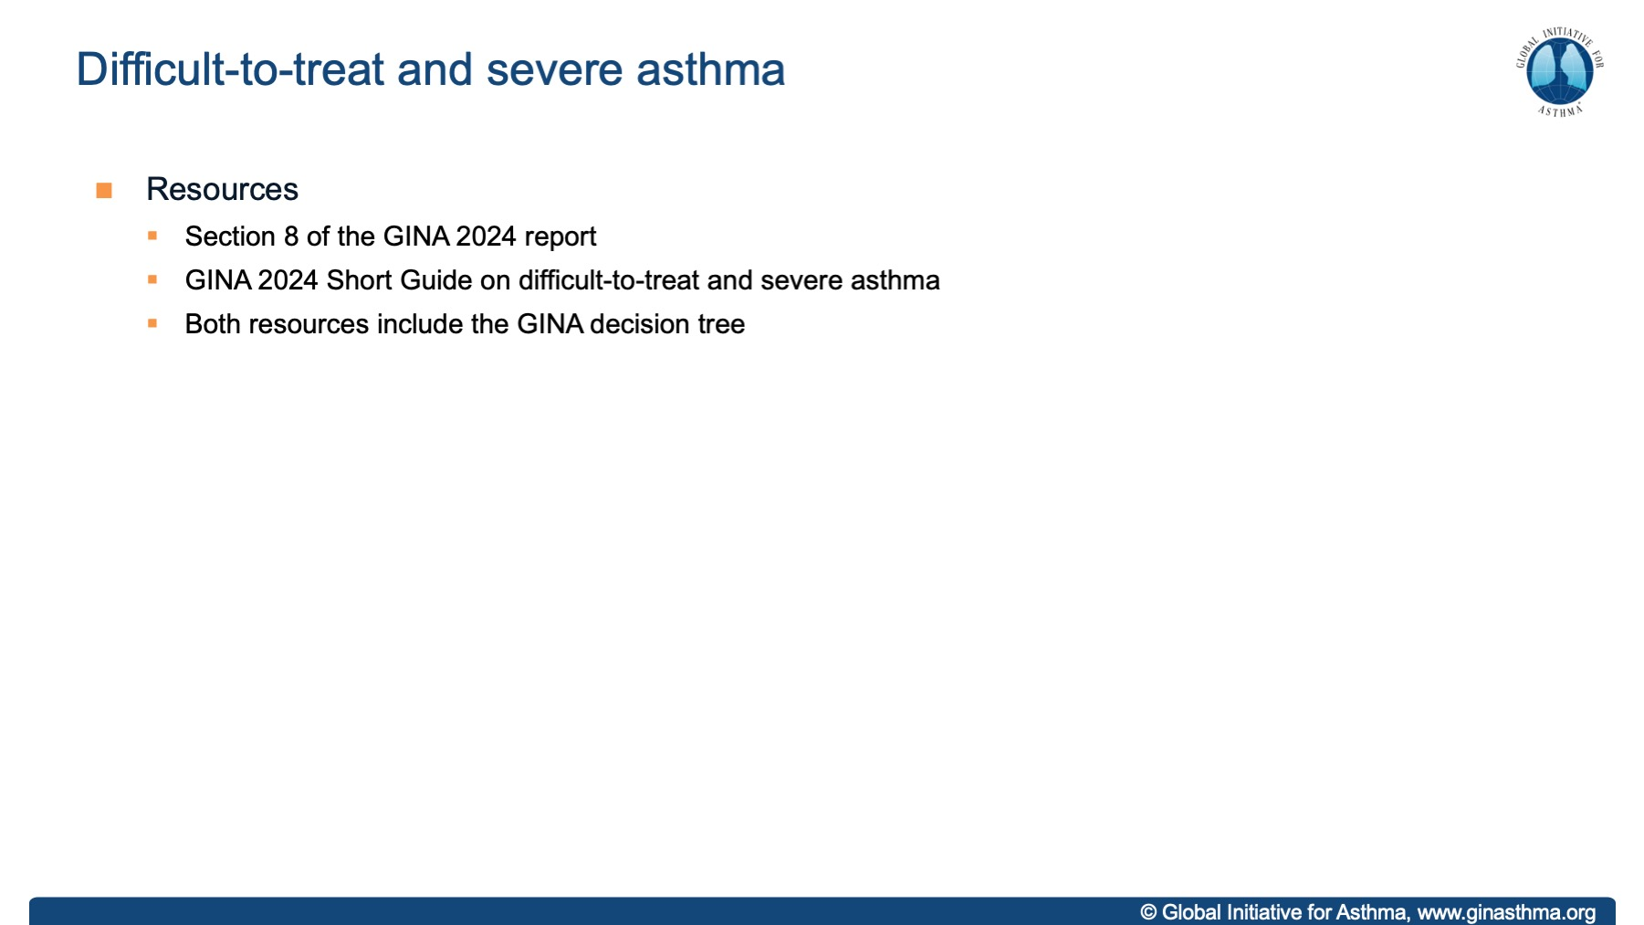

Slide 26
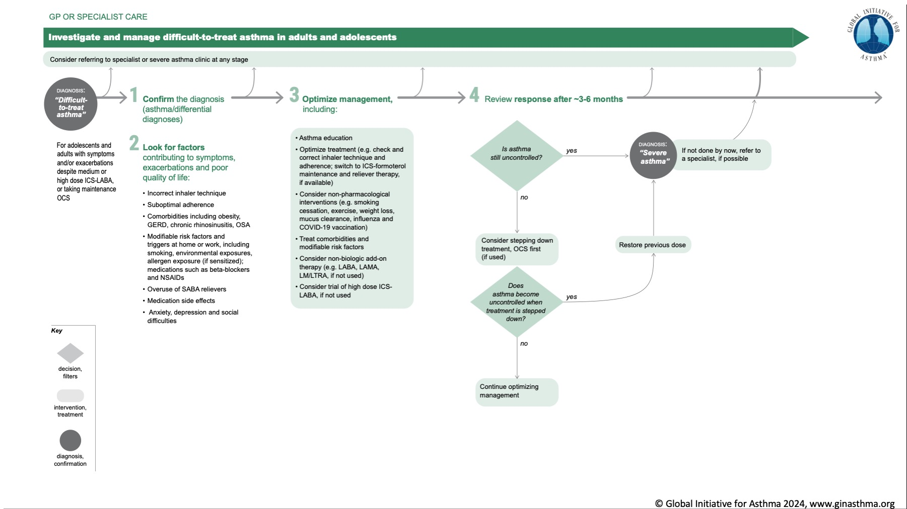

Slide 27
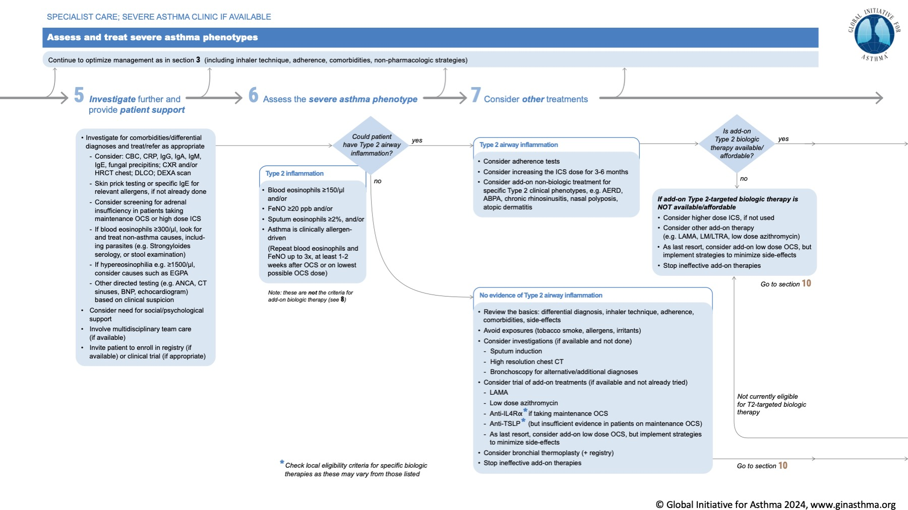

Slide 28
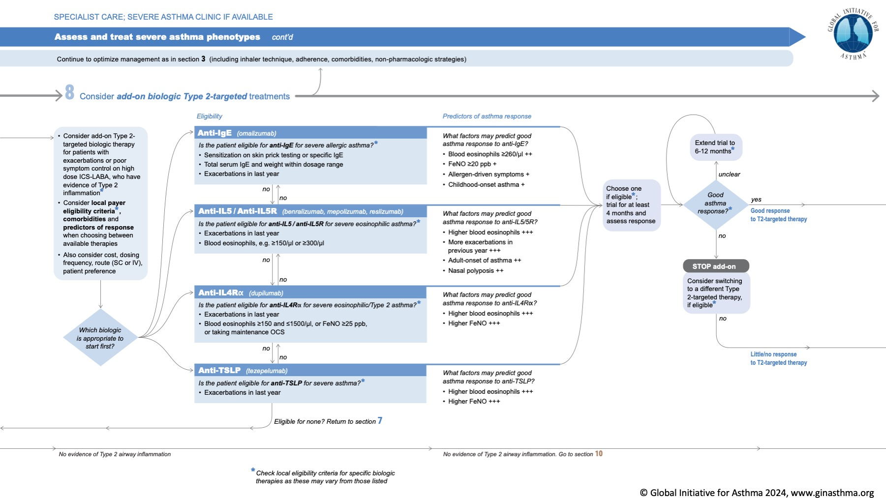

Slide 29
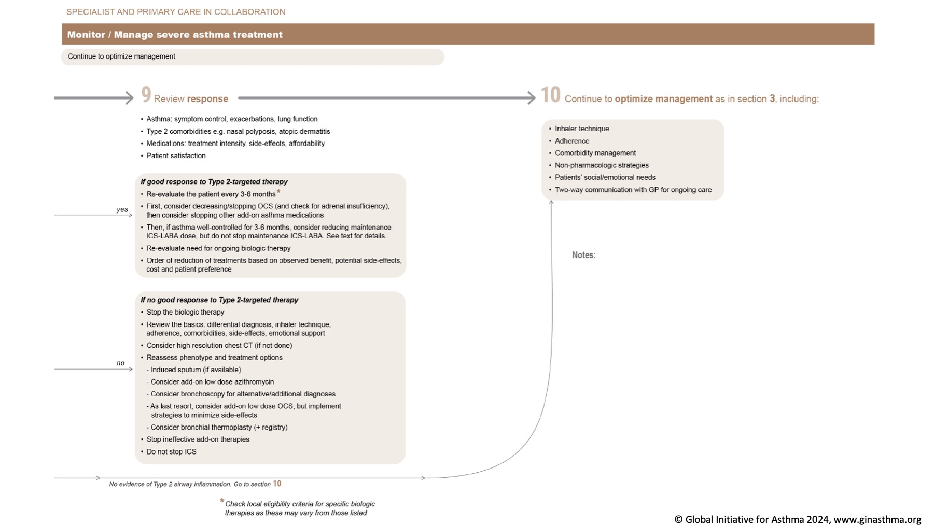

Slide 30
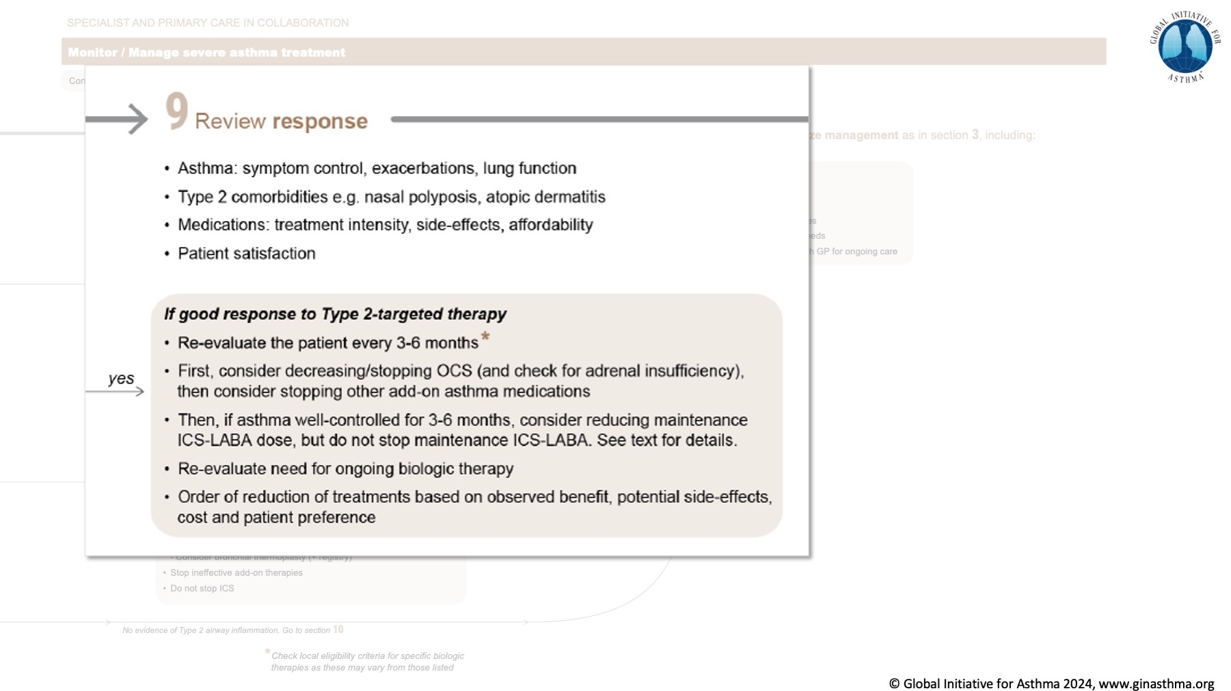

Slide 31
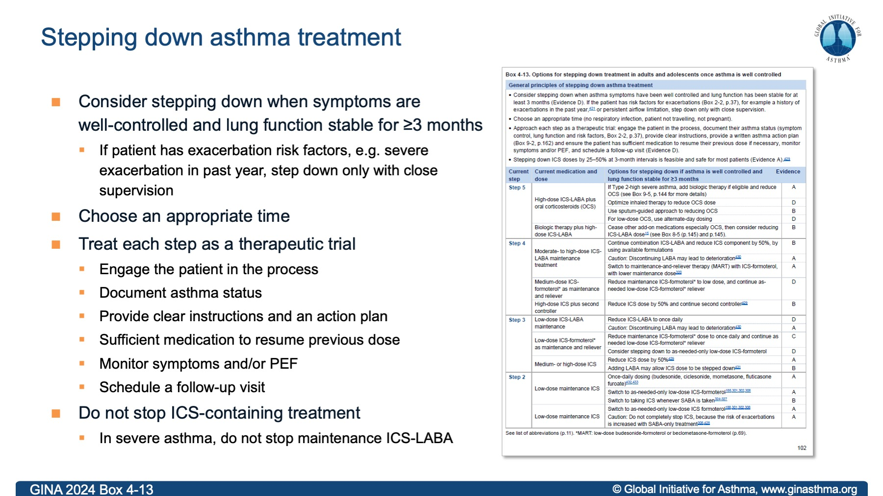

Slide 32
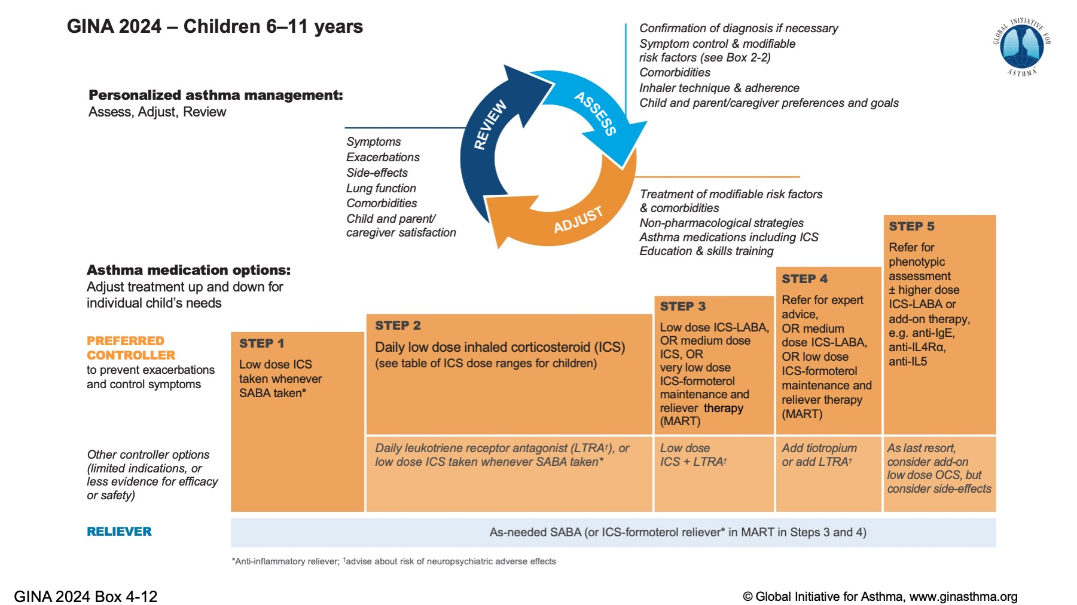

Slide 33
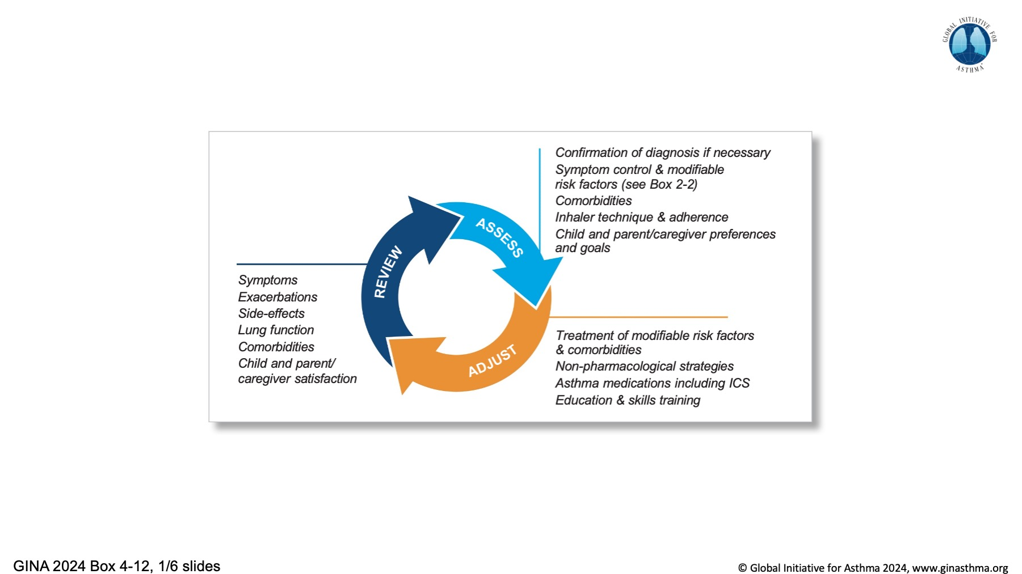

Slide 34
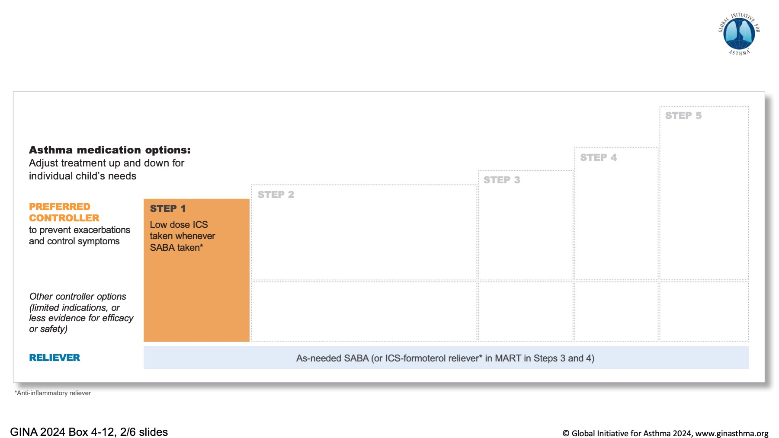

Slide 35
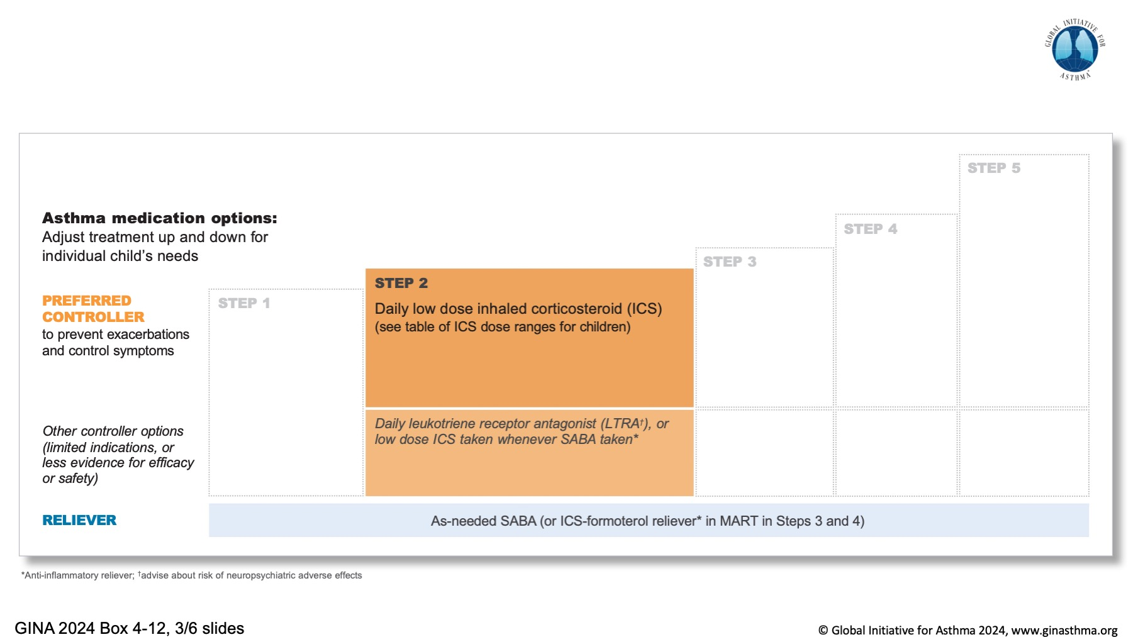

Slide 36
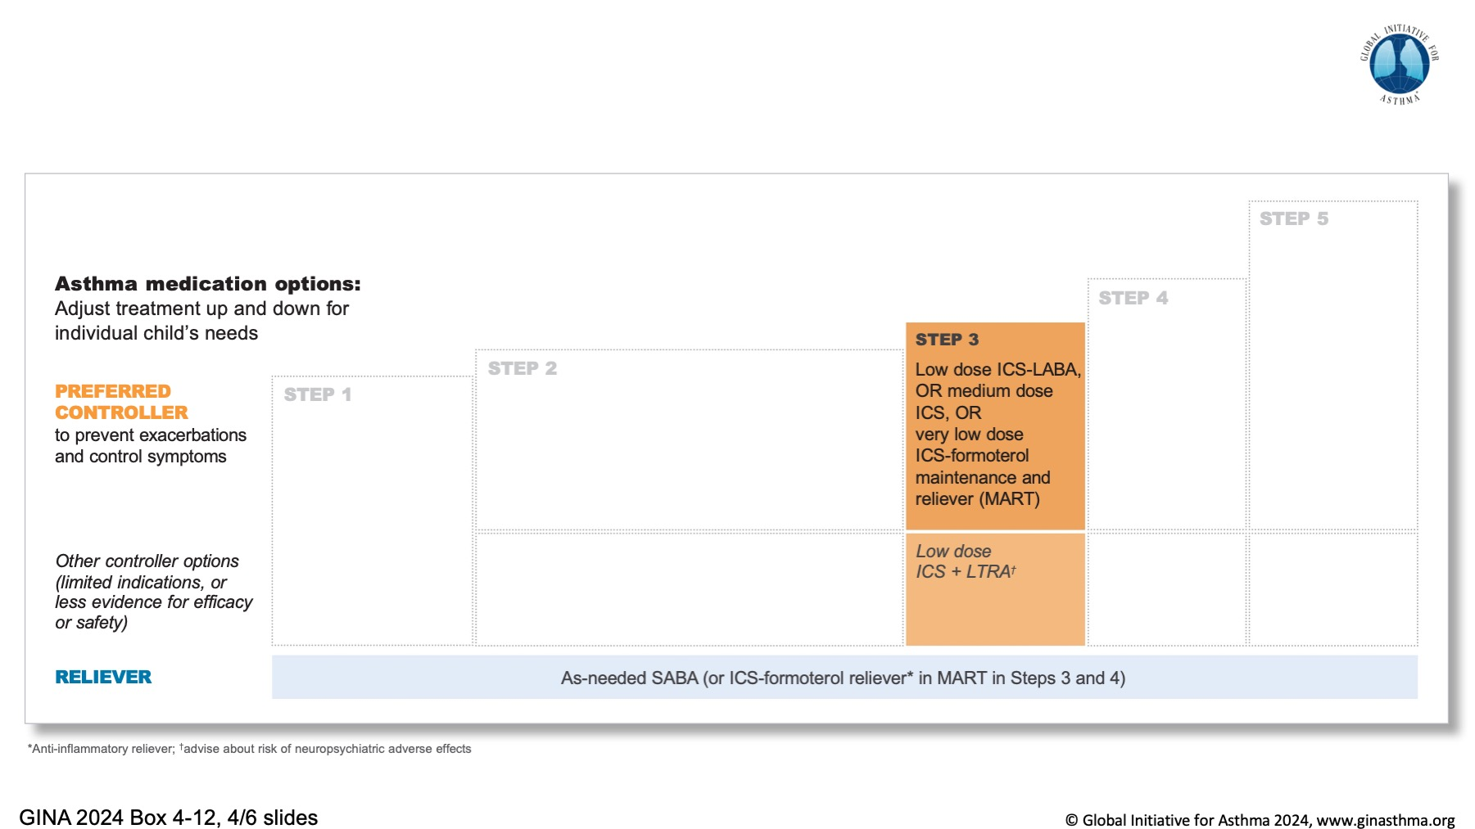

Slide 37
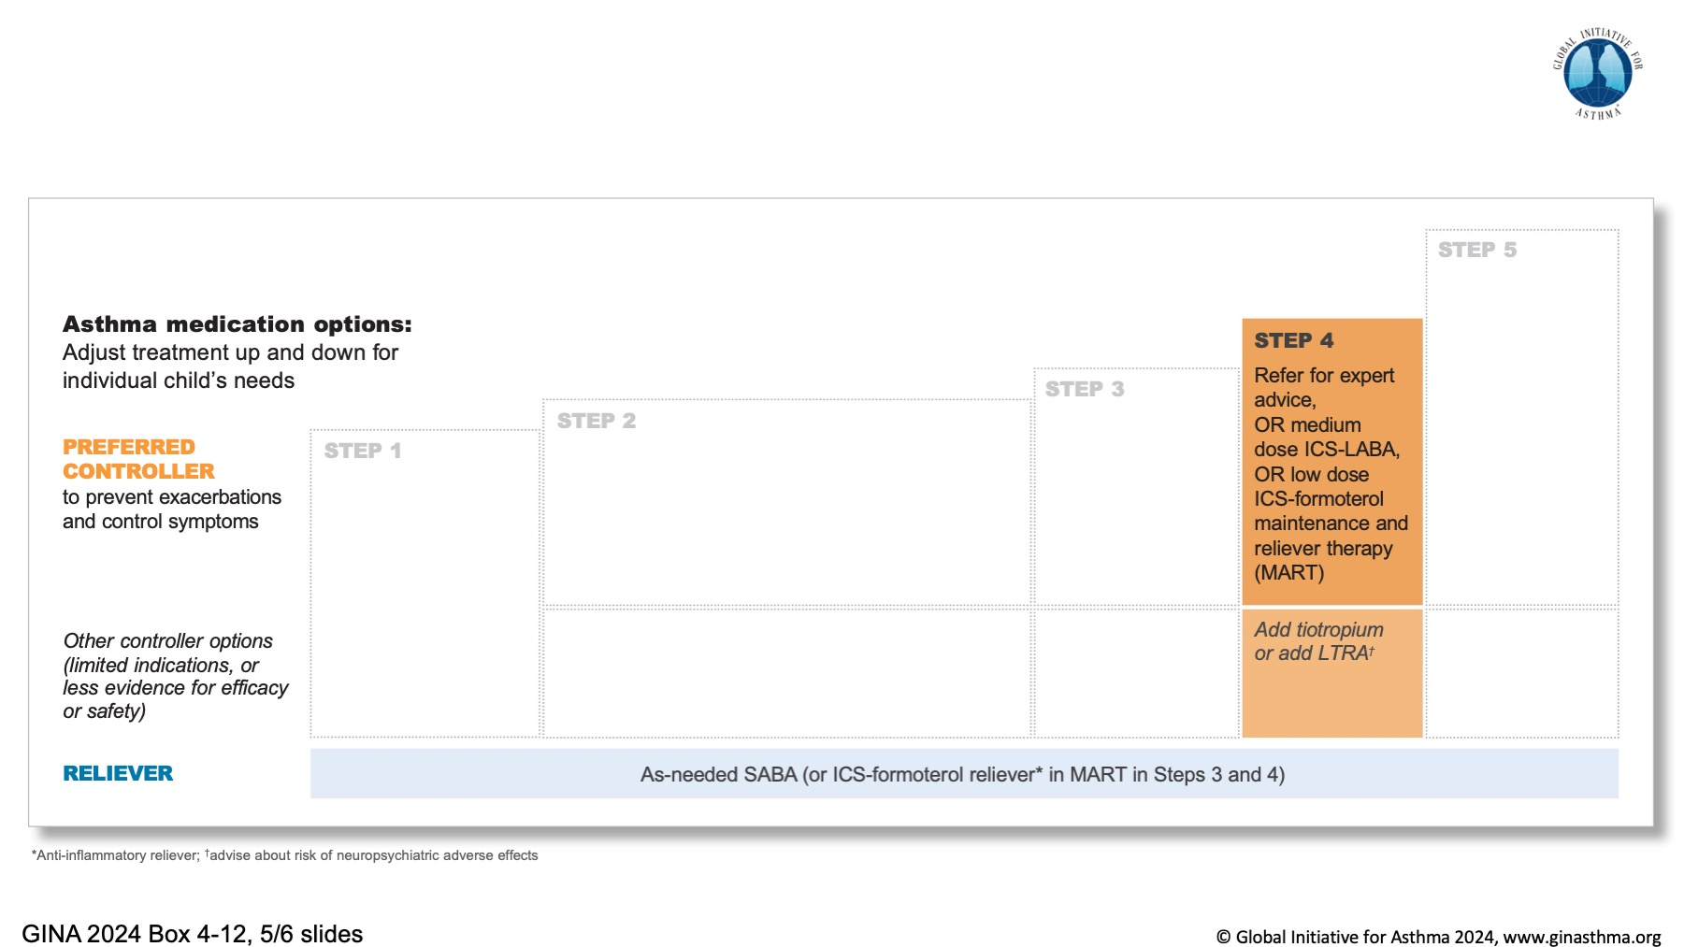

Slide 38
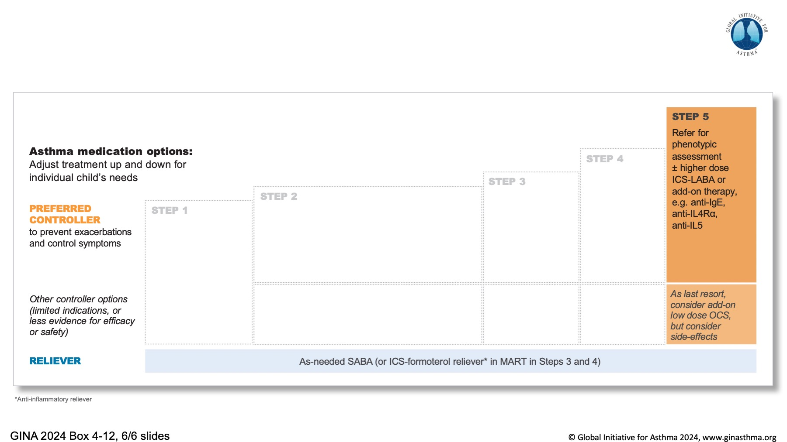

Slide 39
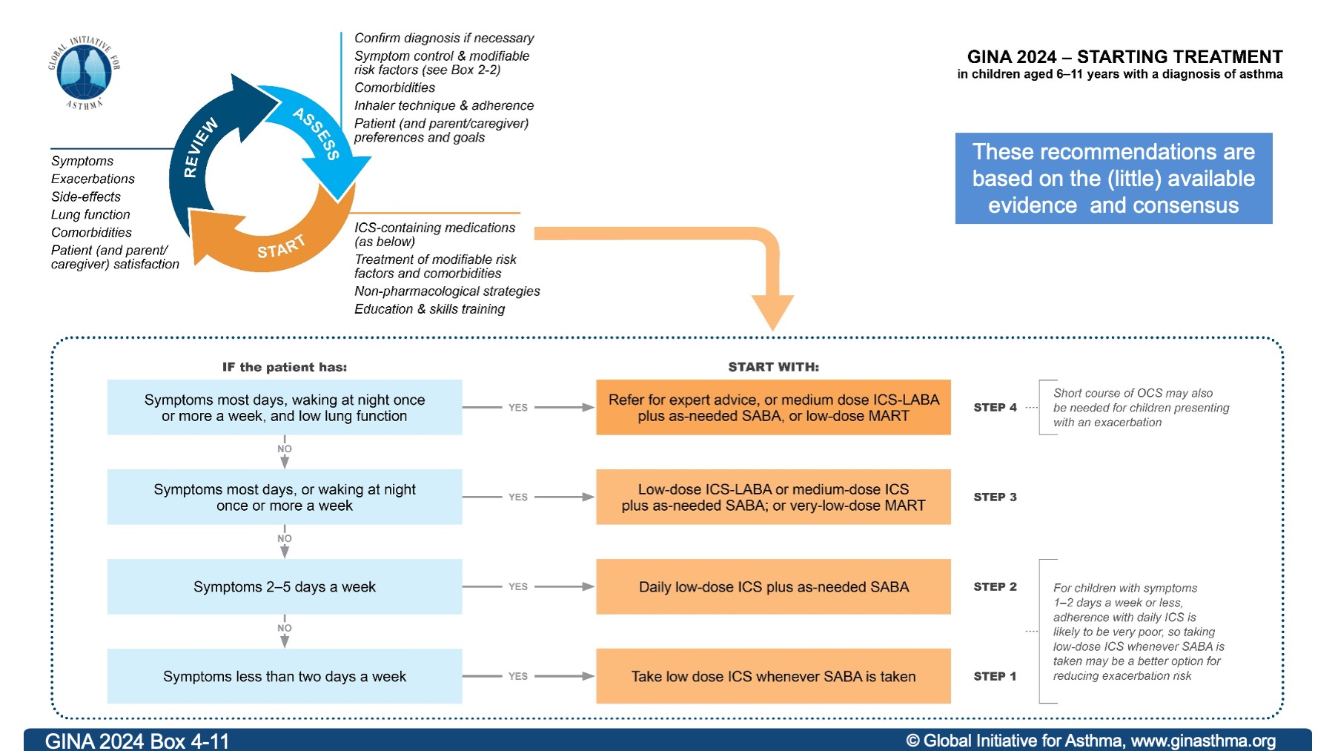

Slide 40
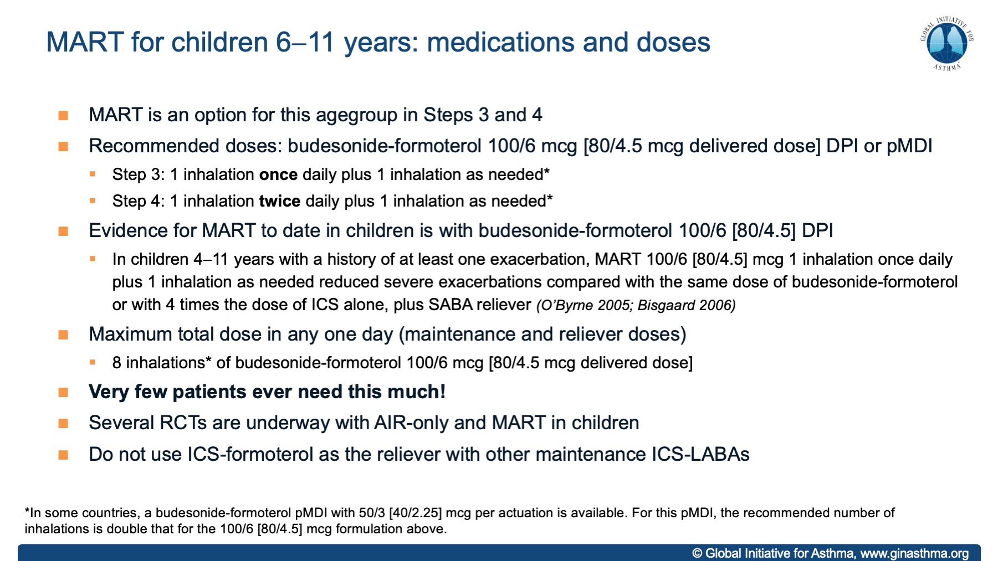

Slide 41
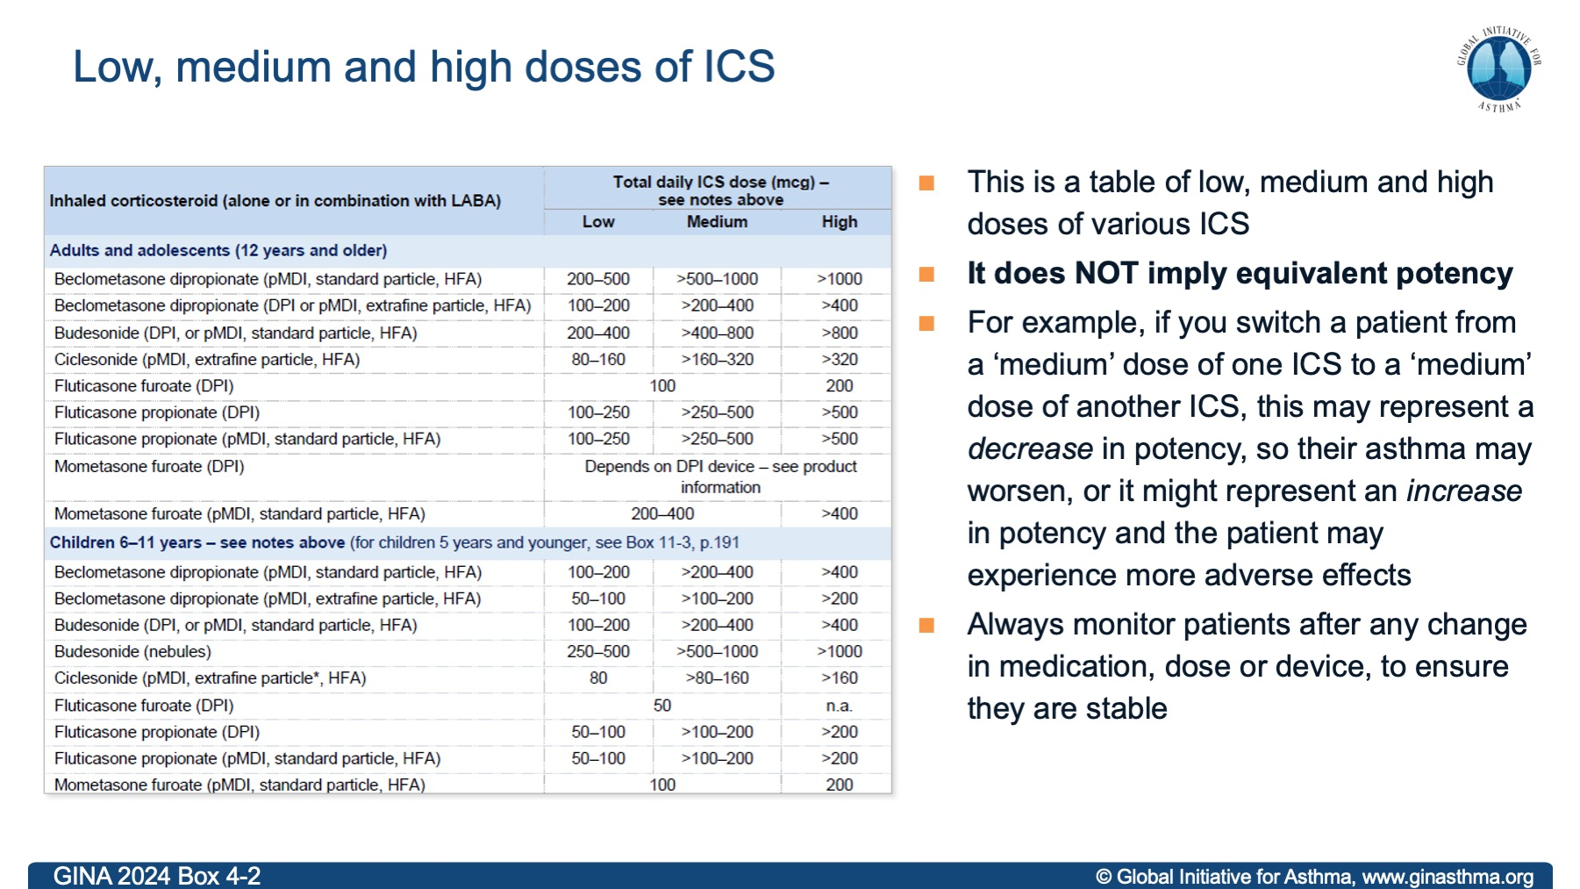

Slide 42
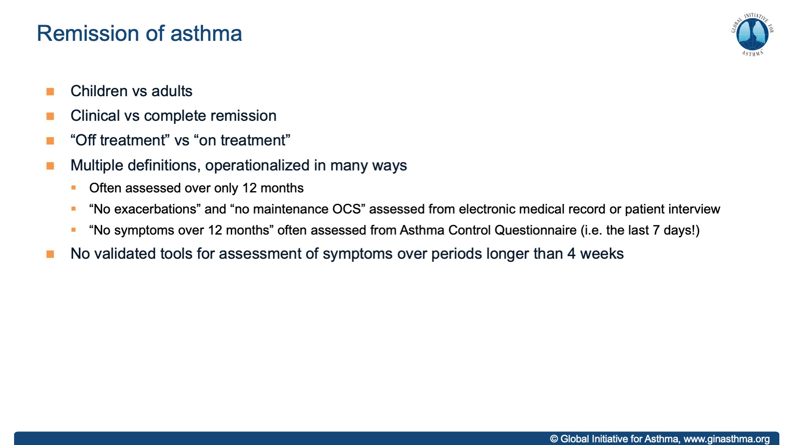

Slide 43
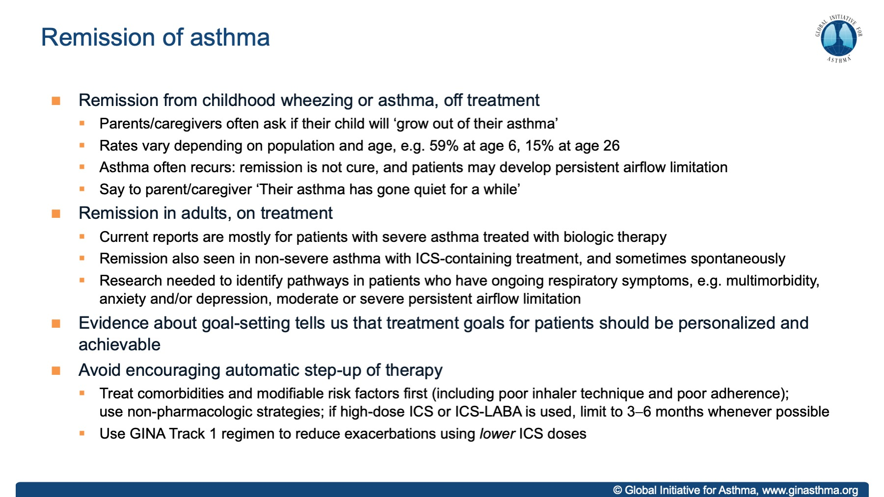

Slide 44
Notes:
NOTE: this slide is also repeated later, with slides about remission

Slide 45
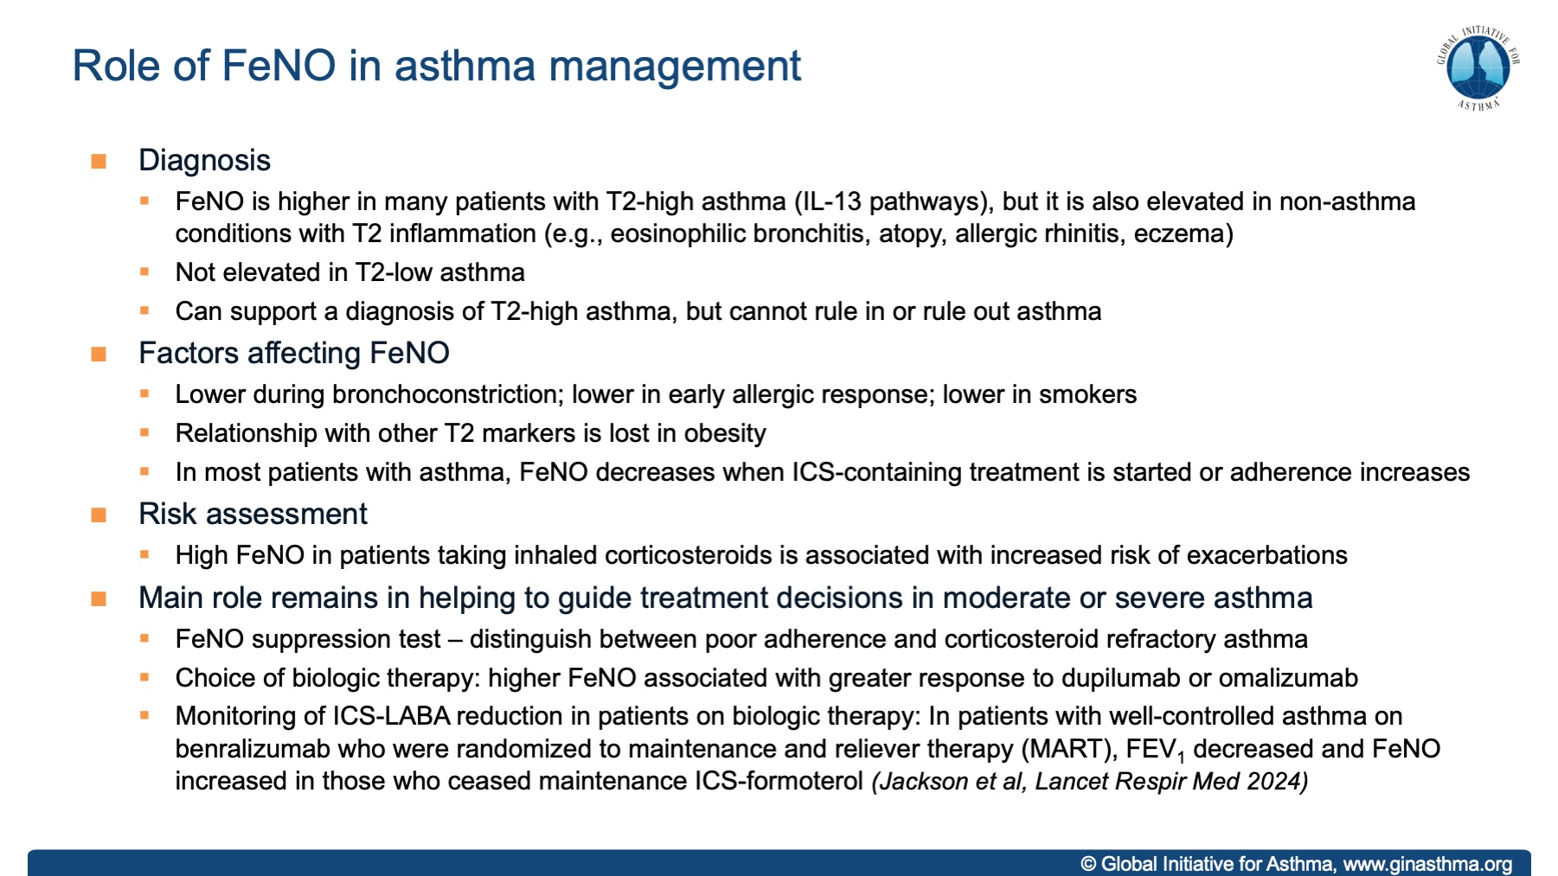

Slide 46
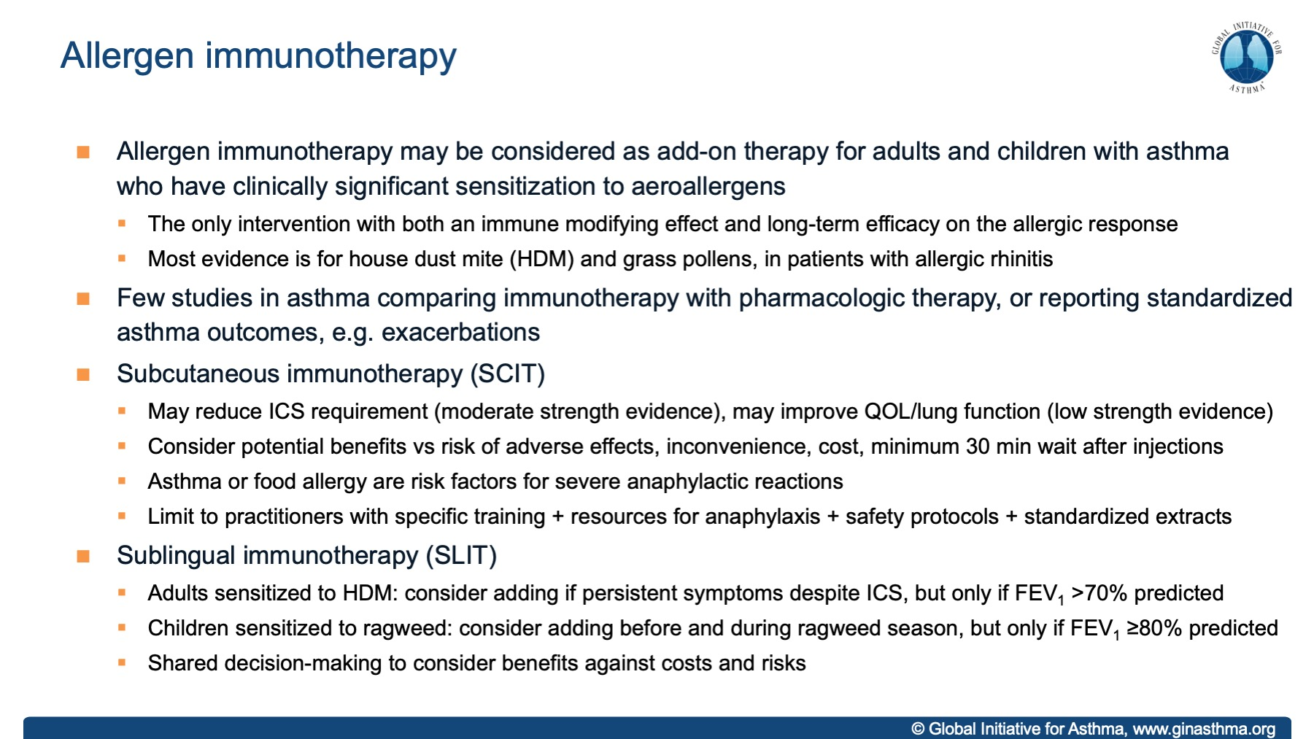

Slide 47
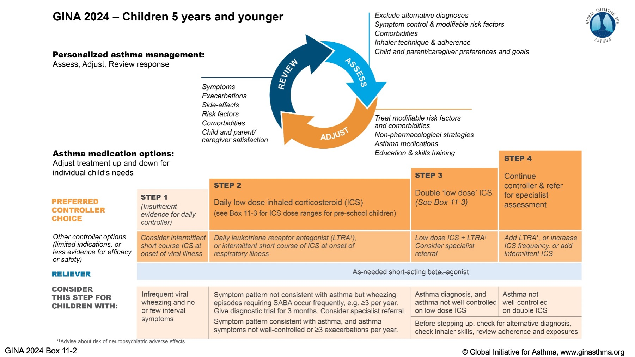

Slide 48
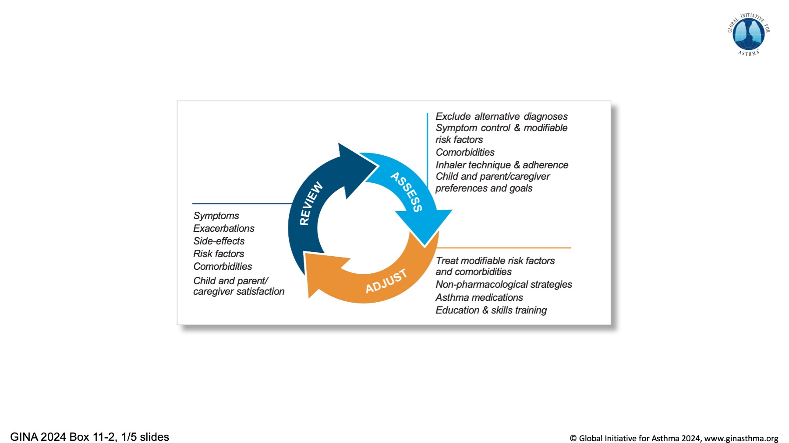

Slide 49
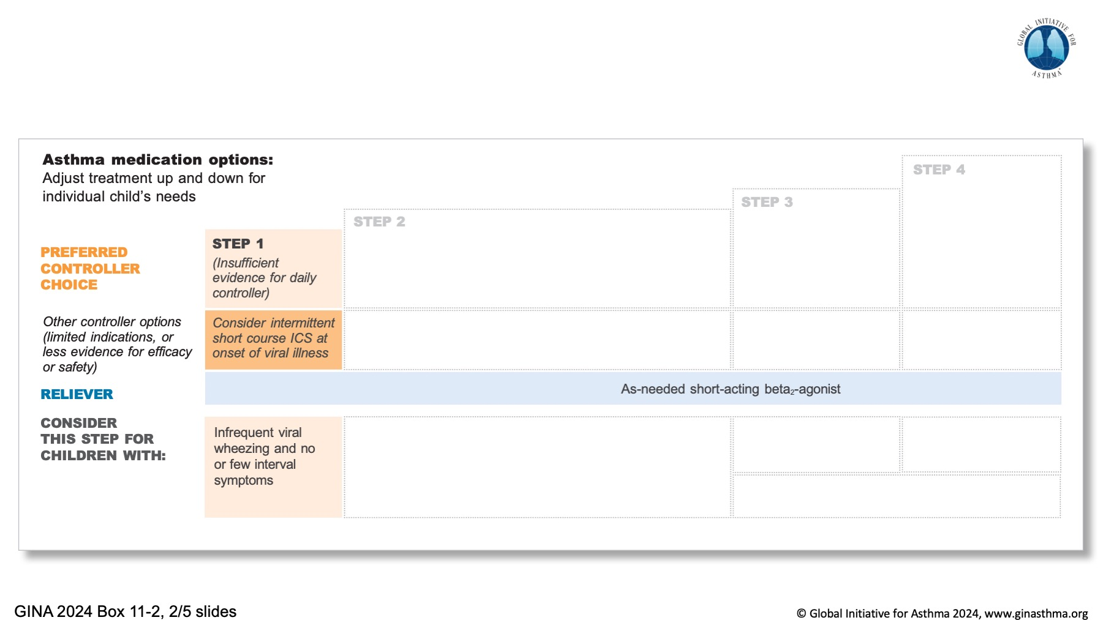

Slide 50
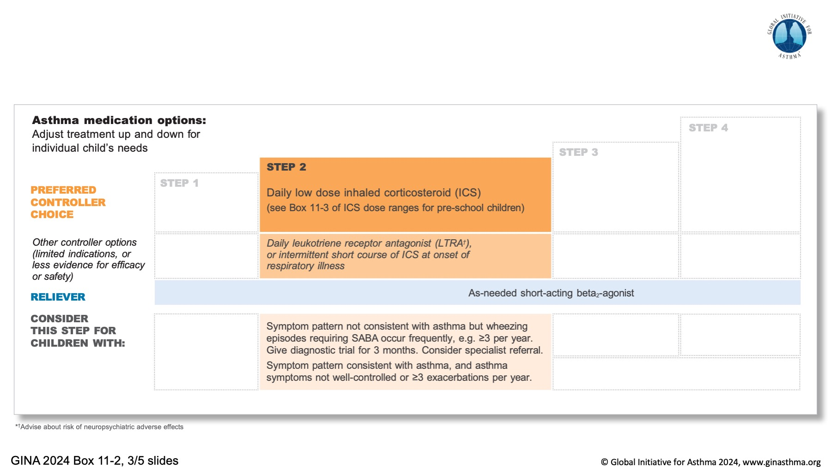

Slide 51
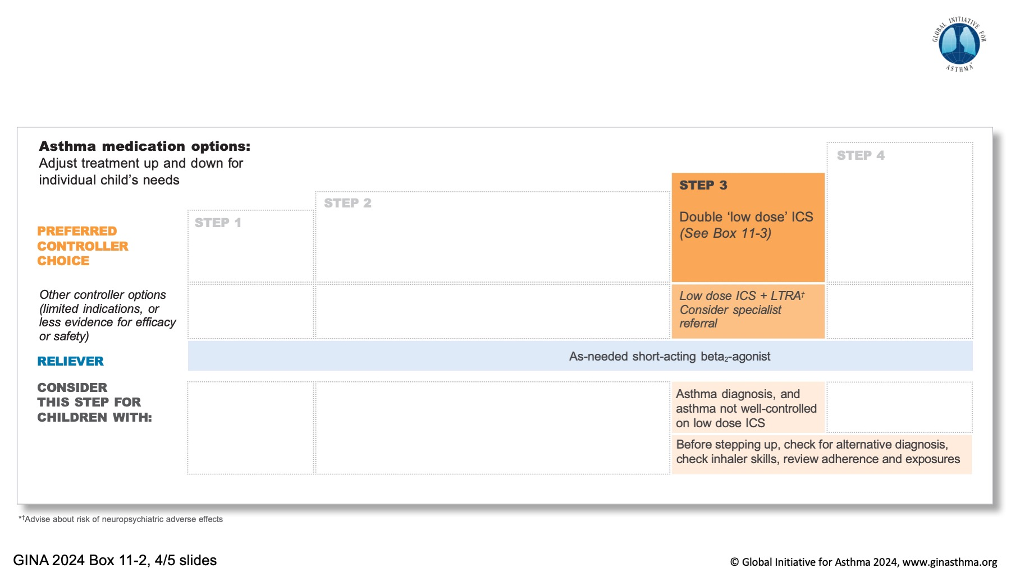

Slide 52
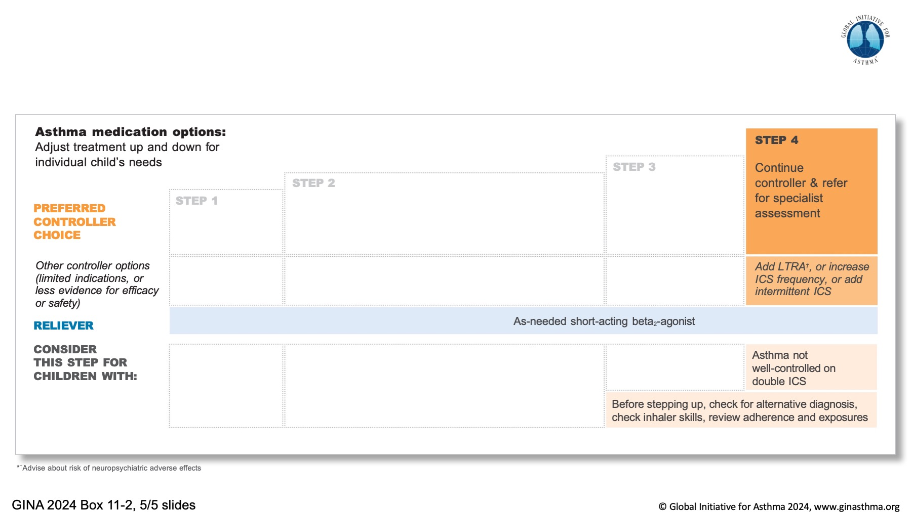

Slide 53

Notes:
NOTE TO SPEAKERS: Delete any item if you are presenting more detailed information about it earlier in the talk

Slide 54

Notes:
Mortimer K, Masekela R, Ozoh OB, Bateman ED, Nantanda R, Yorgancıoğlu AA, et al. The reality of managing asthma in sub-Saharan Africa–Priorities and strategies for improving care. JPATS. 2022;3:105-20.

Slide 55

Notes:
Paris J, Peterson EL, Wells K, Pladevall M, Burchard EG, Choudhry S, et al. Relationship between recent short-acting beta-agonist use and subsequent asthma exacerbations. Ann Allergy Asthma Immunol. 2008;101:482-7.
Emerman CL, Woodruff PG, Cydulka RK, Gibbs MA, Pollack CV, Jr., Camargo CA, Jr. Prospective multicenter study of relapse following treatment for acute asthma among adults presenting to the emergency department. MARC investigators. Multicenter Asthma Research Collaboration. Chest. 1999;115:919-27.
Abramson MJ, Bailey MJ, Couper FJ, Driver JS, Drummer OH, Forbes AB, et al. Are asthma medications and management related to deaths from asthma? Am J Respir Crit Care Med. 2001;163:12-8.

Slide 56


Slide 57


Slide 58


Slide 59


