Slide 1
interpretation of pulmonary function tests
Dr aghaei meybodi

Slide 2
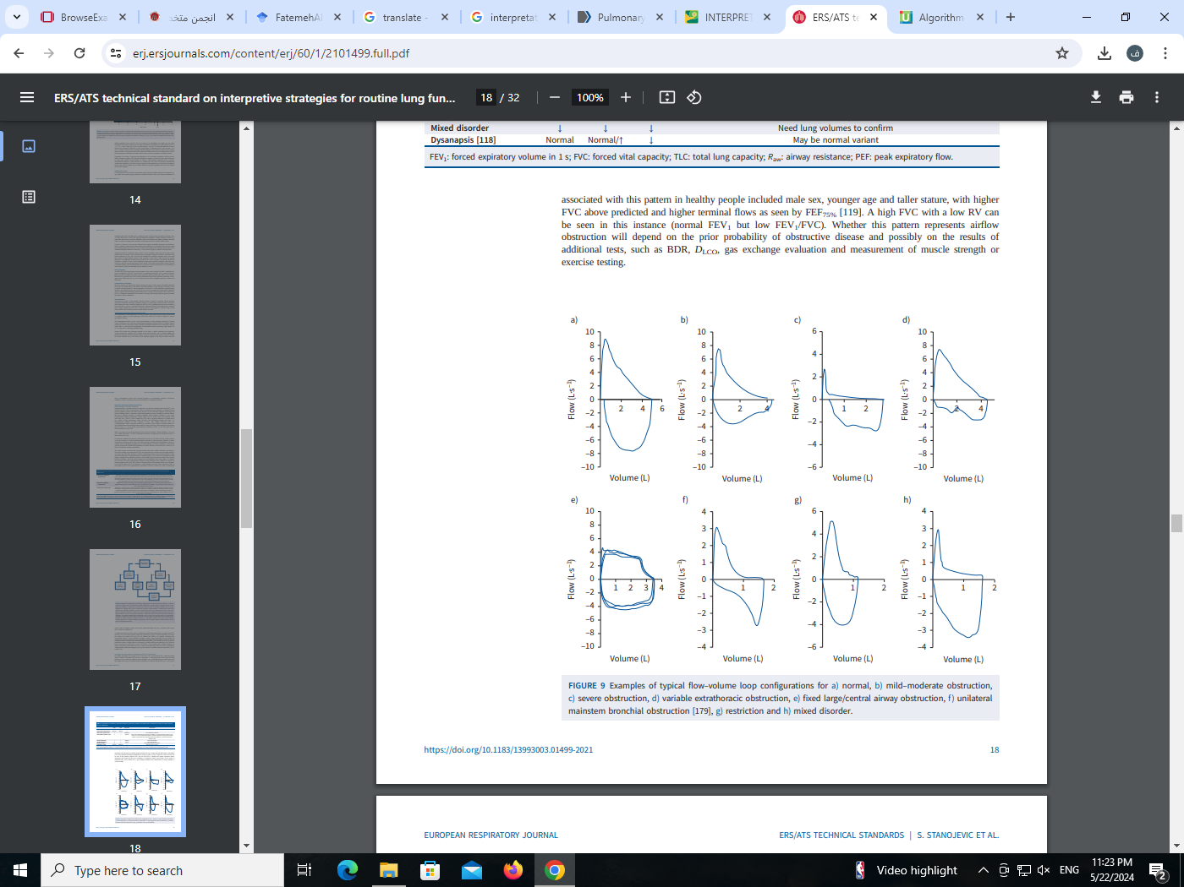

Slide 3
