Slide 1
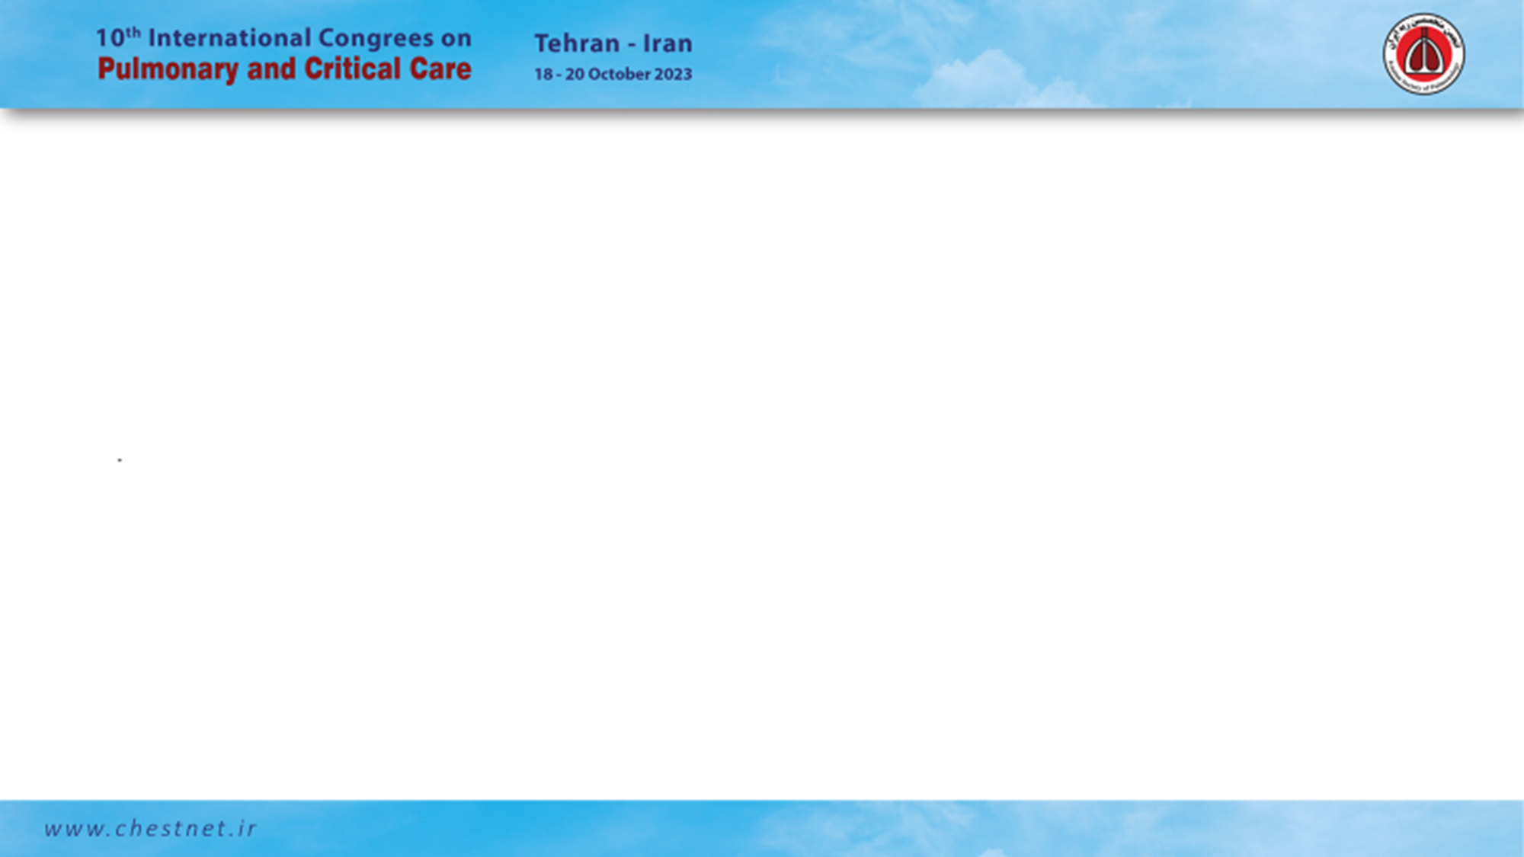
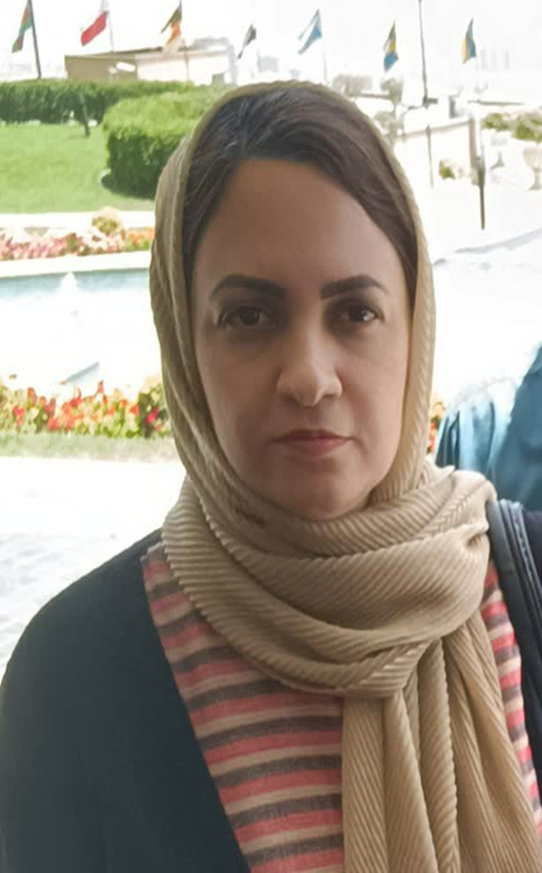
Dr. Fatemeh Sadat Aghaei Meybodi
Associate professor of pulmonary and critical care
MD degree at 2004 from yazd University of Medical Science
Internal medicine specialist degree at 2010 yazd University of Medical Science
Sub specialty in pulmonary and critical care medicine degree at 2013 from shahid Beheshti of tehran University of Medical Science
Research interest: critical care medicine, pulmonary function test, pulmonary obstructive disease
Skills: CPET interpretation, medical education, Examining the clinical competence of medical graduate students
Member of Iranian pulmonology society
Member of European Respiratory society

